Slide 1



Unit 8 Follow your interests
主题范畴：
人与自我
主题群：
做人与做事
子主题：
职业启蒙，职业精神
  Key question:
  How can we turn our
  interests into a career?

Slide 2
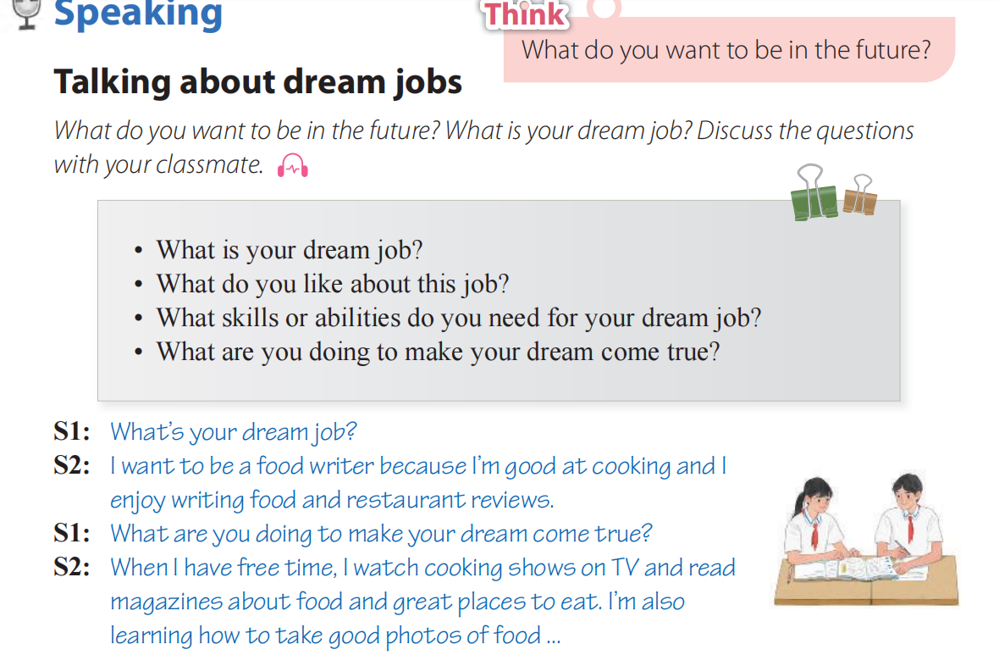
P123

Slide 3
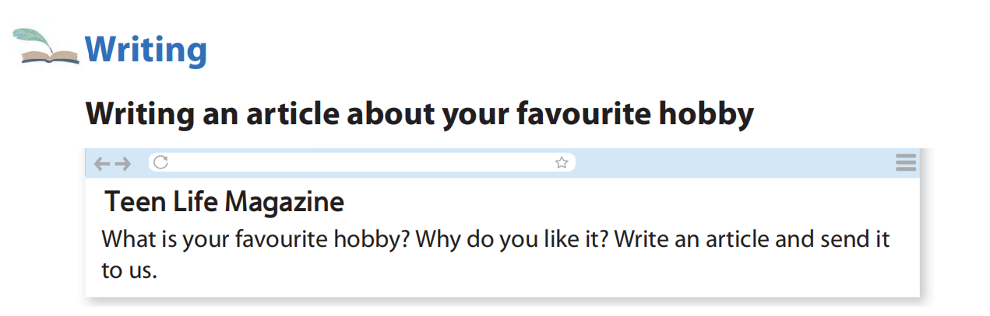

Slide 4
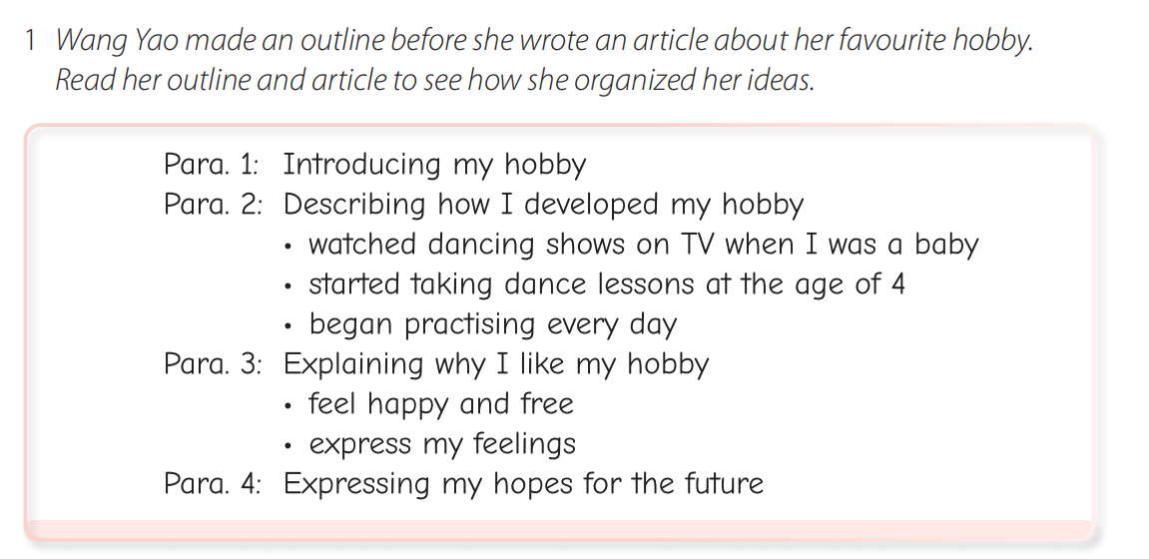
P124

Slide 5
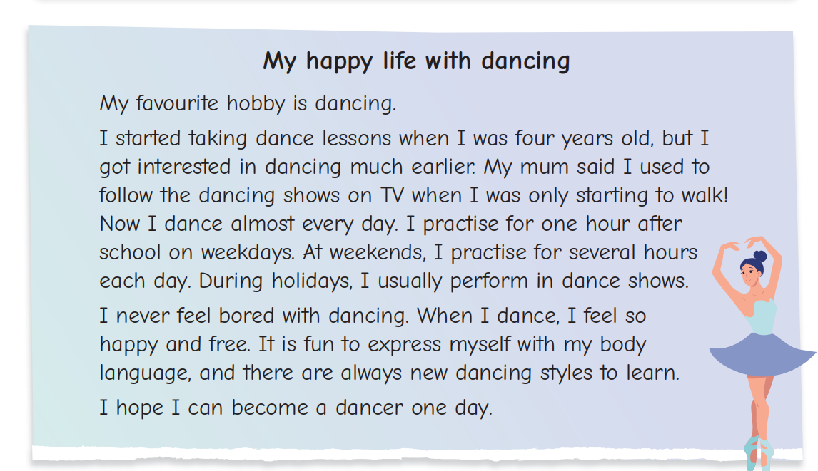

Slide 6
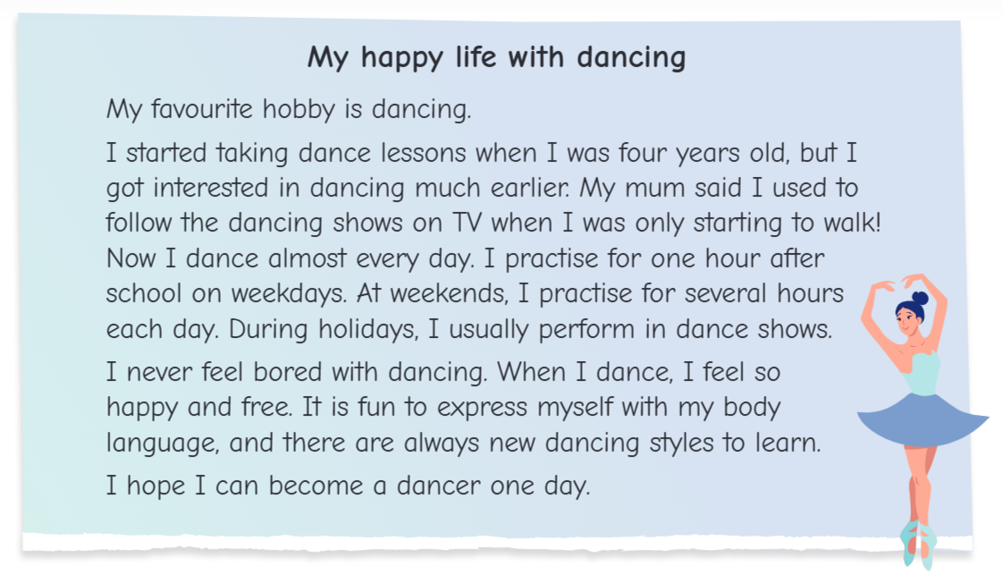
Read for content
Pre-writing
An eye-catching title
A good title should include:
Reflect (反映) the topic of the essay;
Arouse (提高) readers' interest in reading;
Express (表达) the author's emotions.

Slide 7
Read for content
Introducing my hobby
Useful sentence patterns:
My favourite hobby is ...
Doing sth is my favourite hobby.
I enjoy doing ... in my free time.
It is + adj. + for me to do sth.
It is great fun for me to do sth.
I am interested in ...
Tense
simple present tense
一般现在时

Slide 8
Read for content
Tense
Simple past tense
一般过去时
simple present tense
一般现在时
How did I start my hobby
Describing how I
developed my hobby
What did I do for my hobby
How often do I do it

Slide 9
Read for content
Details
Useful sentence patterns:
How did I start my hobby
I started ... when I was ...
At the age of ..., I ...
That was the beginning of ...

Slide 10
Read for content
What did I do for my hobby
How often do I do it
Useful sentence patterns:
I ... every day / once or twice a week.
I usually ... in my free time.

Slide 11
Read for content
Useful sentence patterns:
Explaining why I like my hobby
When I ..., I feel ...
It was + adj. + (for me) + to do sth
Doing sth was + adj. + for me.
Tense
simple present tense
一般现在时
Emotion + effect

Slide 12
Read for content
Rewrite the sentence
It is fun to express myself with my body language.
Doing sth was + adj. + for me.
Expressing myself with my body language was fun for me.

Slide 13
Read for content
Expressing my hopes for the future
Useful sentence patterns:
I'm looking forward to ...
I hope (that) ...
Tense
simple present tense
一般现在时

Slide 14
Now try to draw your mind map and write down your dream!

Slide 15
Step 1 Plan Brainstorm ideas and make an outline to organize them. You may refer to Wang Yao's outline and article in Exercise 1.
Introducing my hobby
How did I start: ______
Describing how I developed my hobby
What did I do : ______
How often : ______
Title
Explaining why I like my hobby
Emotion: ______
Effect: ______
Expressing my hopes for the future

Slide 16
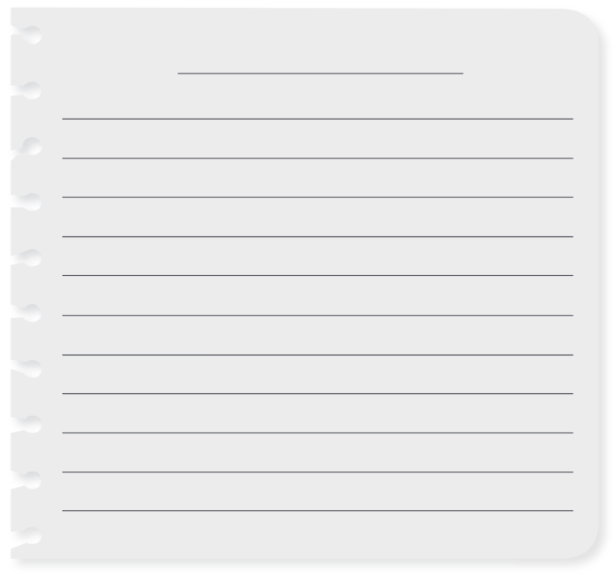

Step 2 Write Write about your favourite hobby. Try to give your article an eye-catching title.

Slide 17
Post-writing
Step 3 Check and revise
Tick (✔)the boxes to check your writing, and then revise it.
Check and revise
I introduced my favourite hobby clearly at the beginning.
I explained how I developed my hobby and why I like it.
I used the words and expressions I learnt in this unit.
I used correct spelling, grammar and punctuation.

Slide 18

Useful expression
__________________
__________________
__________________
__________________
对……感兴趣
在舞蹈节目里表演
对……感到厌倦
肢体语言
get interested in ...
perform in dance show
feel bored with
body language

Slide 19
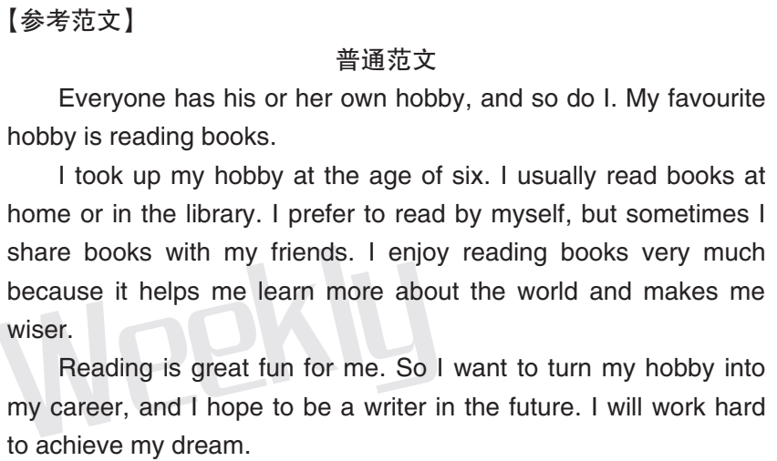
Unit 8 Writing 语言知识讲练
七年级Unit 8 第14版

Slide 20
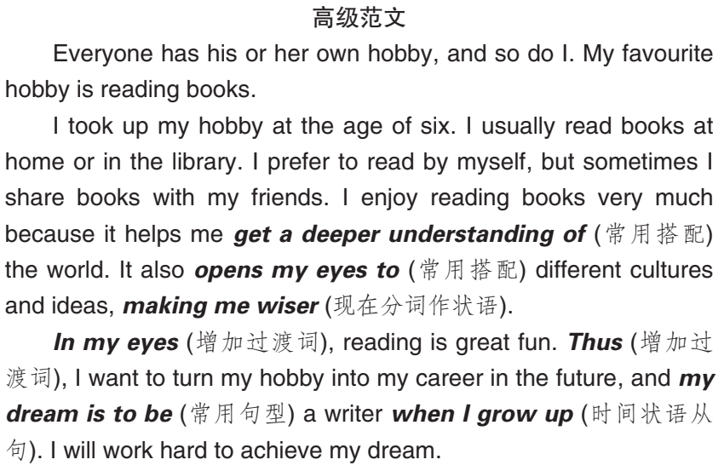
Unit 8 Writing 语言知识讲练
七年级Unit 8 第14版

Slide 21
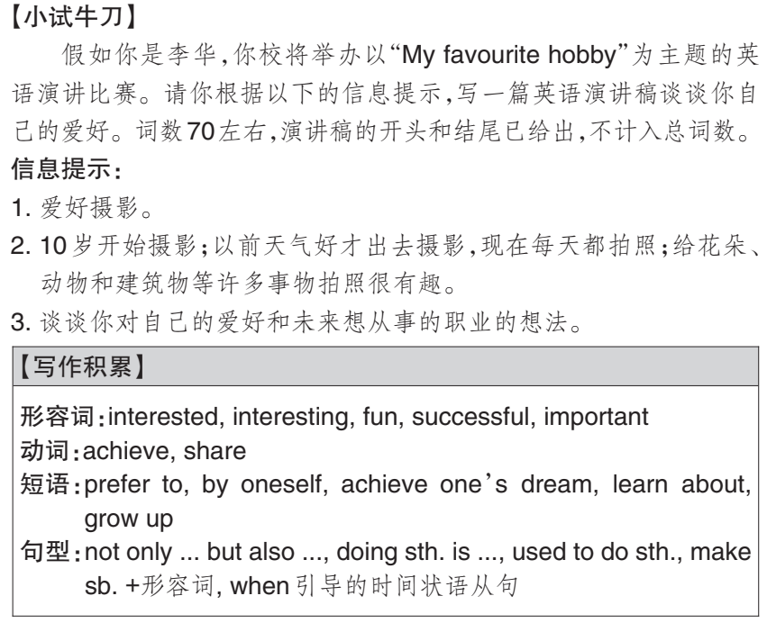
Unit 8 Writing 语言知识讲练
七年级Unit 8 第14版

Slide 22
Unit 8 Writing 语言知识讲练
七年级Unit 8 第14版
Hello, everyone! My name is Li Hua. I want to
talk about my favourite hobby. _______________
________________________________________
________________________________________
________________________________________
________________________________________
________________________________________
My favourite
hobby is taking photos.
I started taking photos at the age of ten. I used
to go outside with my camera on sunny days. Now
I take photos every day. It is interesting for me to
take photos of different things such as flowers,

Slide 23
Unit 8 Writing 语言知识讲练
七年级Unit 8 第14版
animals and buildings.
In my eyes, taking photos can help me
remember valuable moments in my life and learn
more about different places in the world. Thus, I
want to be a photographer when I grow up. I will
work hard to achieve my dream.
________________________________________
________________________________________
________________________________________
________________________________________
________________________________________
________________________________________
That’s all. Thanks for listening!

