Slide 1

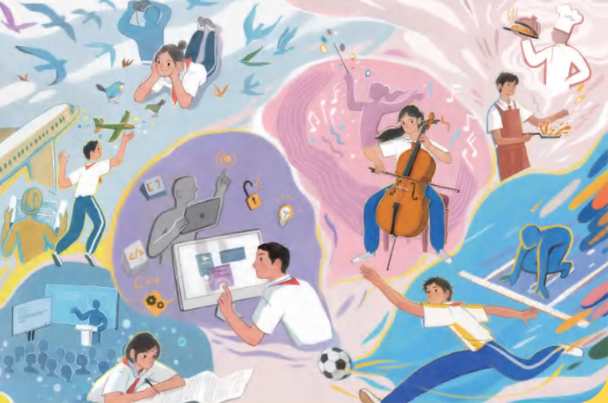

Unit 8 Follow your interests
主题范畴：
人与自我
主题群：
做人与做事
子主题：
职业启蒙，职业精神
  Key question:
  How can we turn our
  interests into a career?

Slide 2
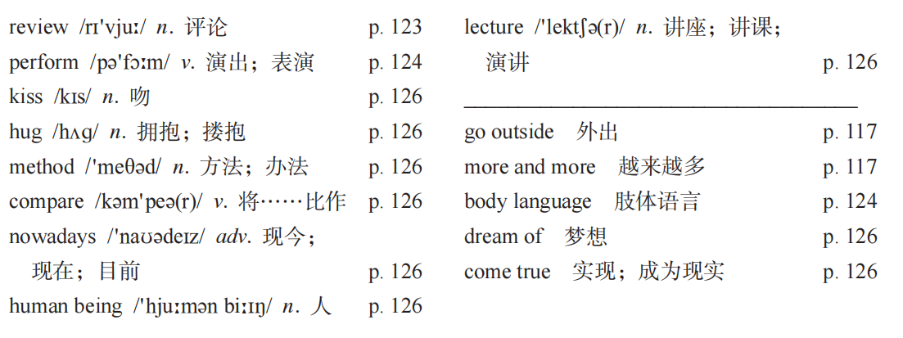

Slide 3



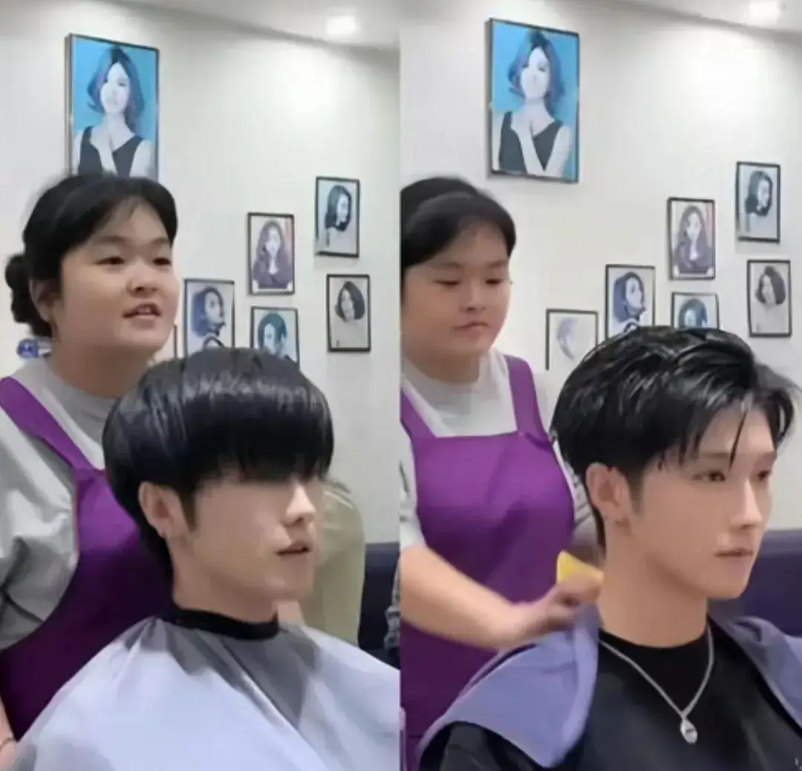


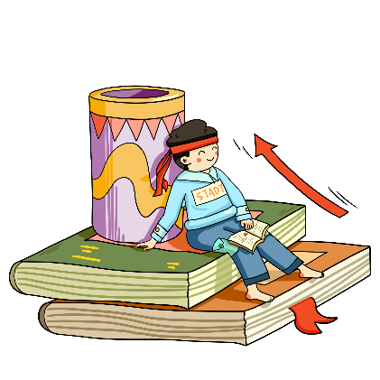

compare /kəmˈpeə(r)/ v. 对比；比较
comparison n. 比较；对照
comparable adj. 可比较的
compare with 与…相比
compare to 把…比作

Slide 4
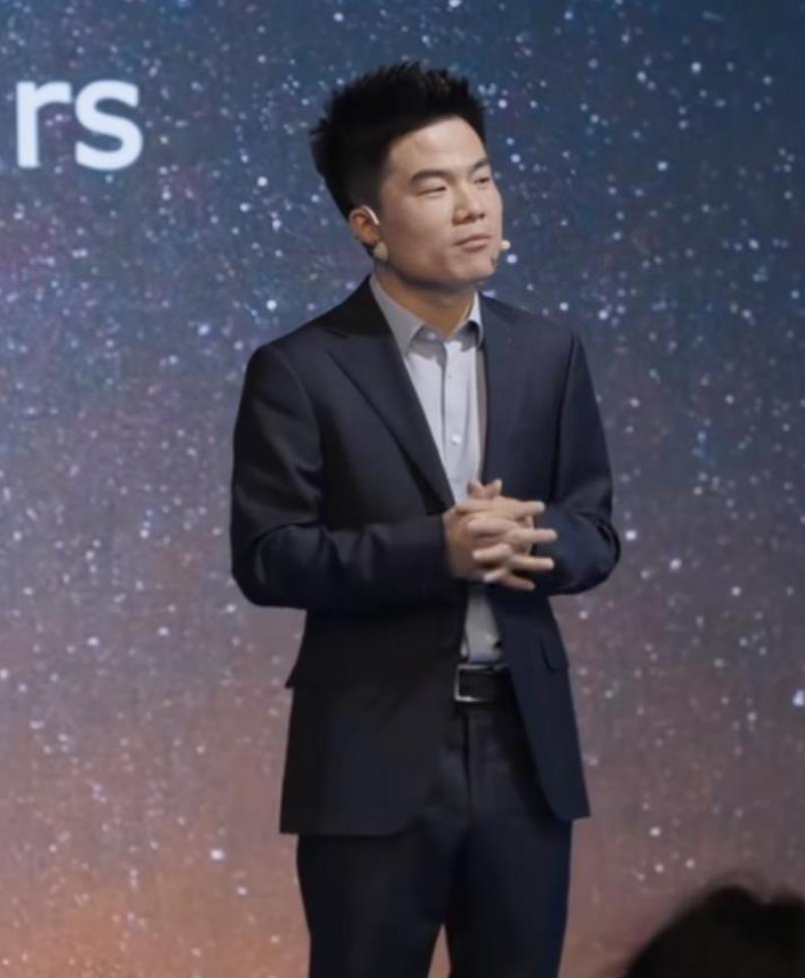
lecture /ˈlektʃə(r)/ n. 讲座；讲课；演讲；v. 讲课
lecturer n. 讲师；演讲者
attend a lecture 参加讲座
give a lecture 做讲座
lecture hall 演讲厅
eg. She lectured the class about safety rules.
eg. The professor gave a lecture on climate change.
她给班级讲了安全规则
教授做了一个关于气候变化的讲座

Slide 5
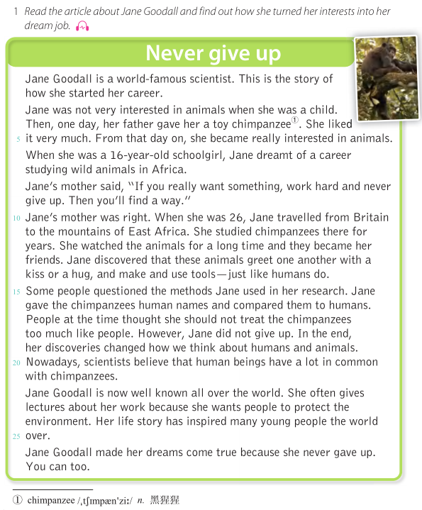
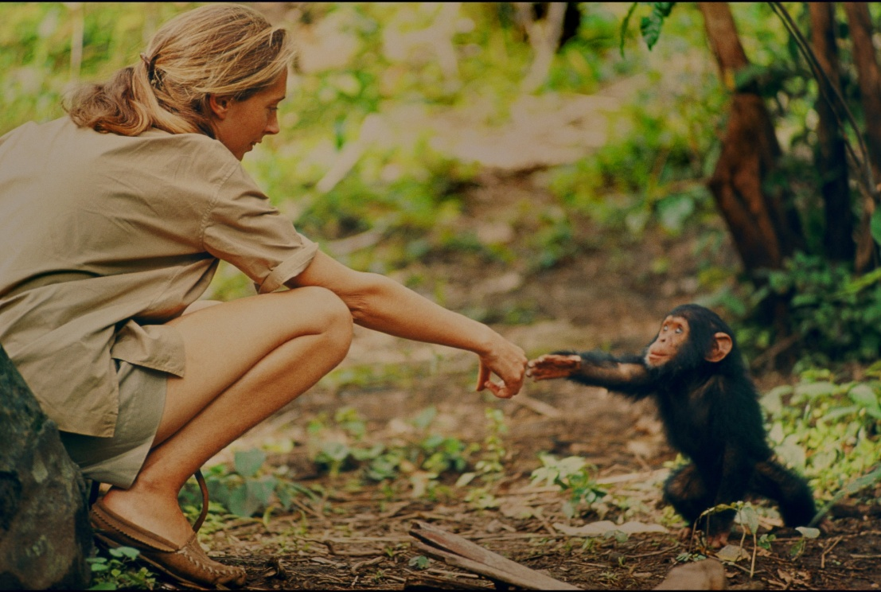
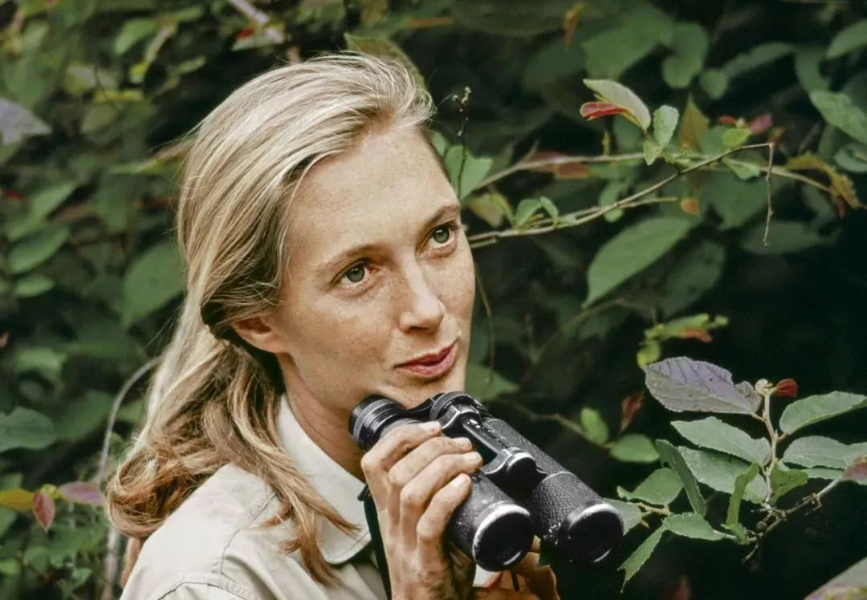

Jane Goodall 珍·古道尔
P126
Why was she world-famous？
How did she make her dream come true？
1
2
3
4
5
Mark all paragraphs
6
Jane Goodall(1934-2015), zoologist (a person who studies animals)
7
8

Slide 6
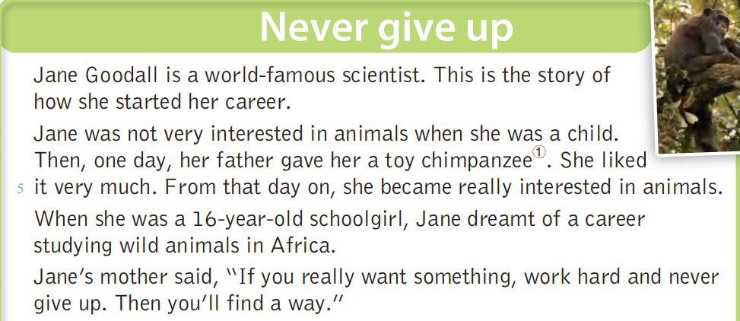
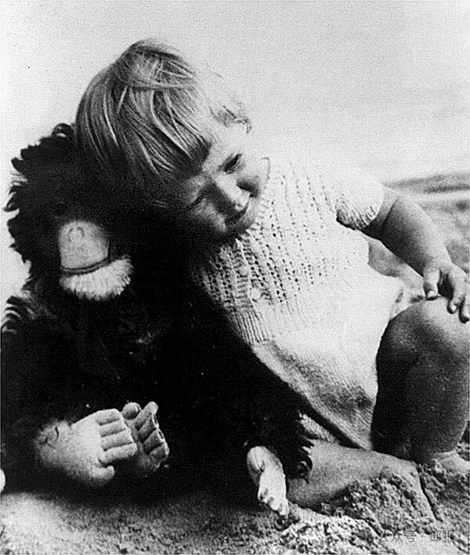
Para.1-4
1、What was Jane Goodall’s interest？
How did she start her interest？
1
2、What was her dream job？
2
3、What did her mother do？
She encouraged her to work hard and never give up.
3
4

Slide 7
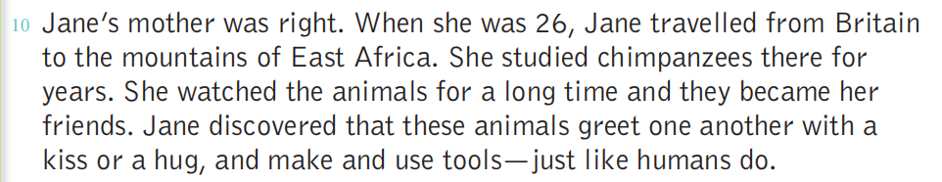
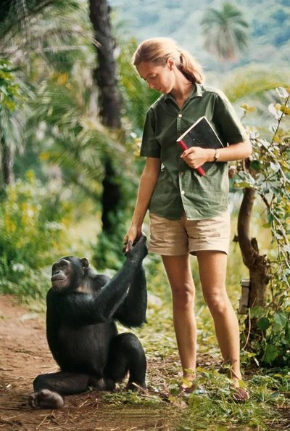
Para.5
1、When did she get her dream job？
2、What did she do in East Africa？
3、What did she find out？

Slide 8
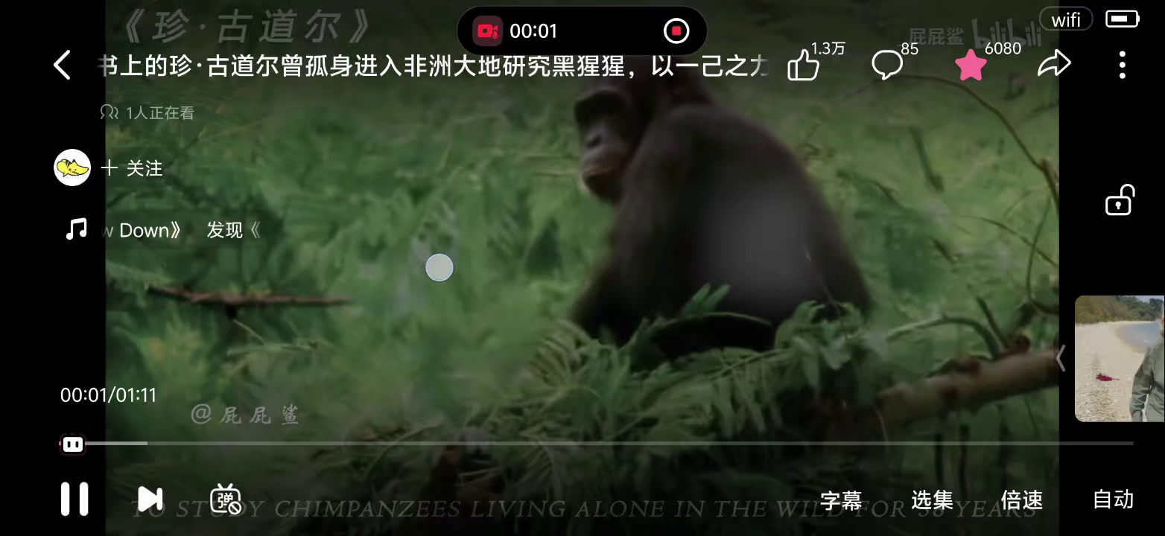

Slide 9
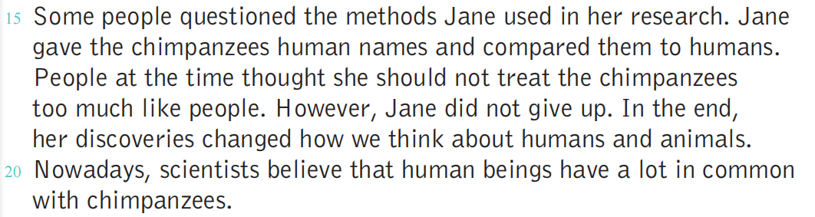
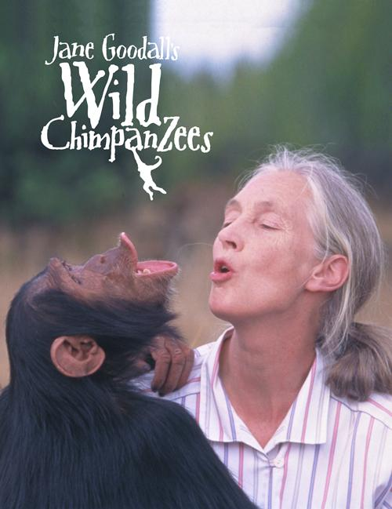
Para.6
1、Did people agree with her discoveries at first？
2、What were “the methods” used in Jane’s research？
3、What did Jane do when facing people’s questions ？
4、What do people believe now ？

Slide 10
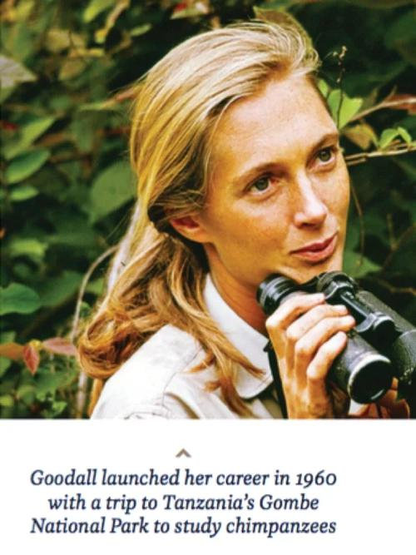
What do you think of Jane Goodall？
I think Jane Goodall was...because...
tough，brave， determined，
hard-working，patient，friendly，careful......

Slide 11
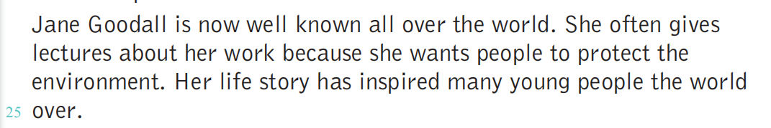
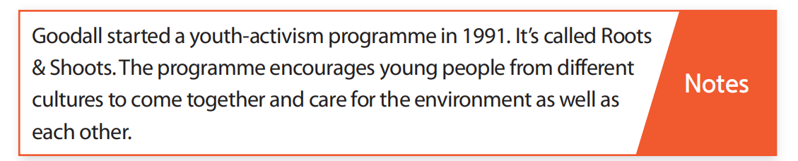
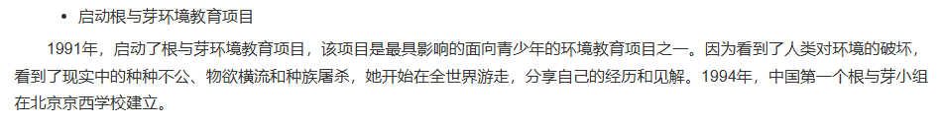
Para.7
Further think：
1、What do you think made Jane Goodall bacome well-known ？
Her long-term research，her famous discoevries about the chimpanzees，and her contributions to the wildlife protection.
2、What did her life story inspire many young people to do ？
Her life story inspired people to...

Slide 12
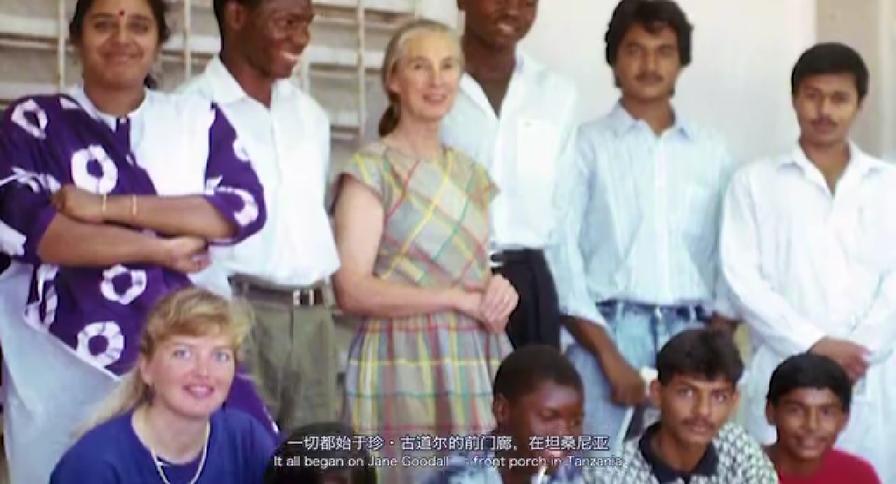

Slide 13

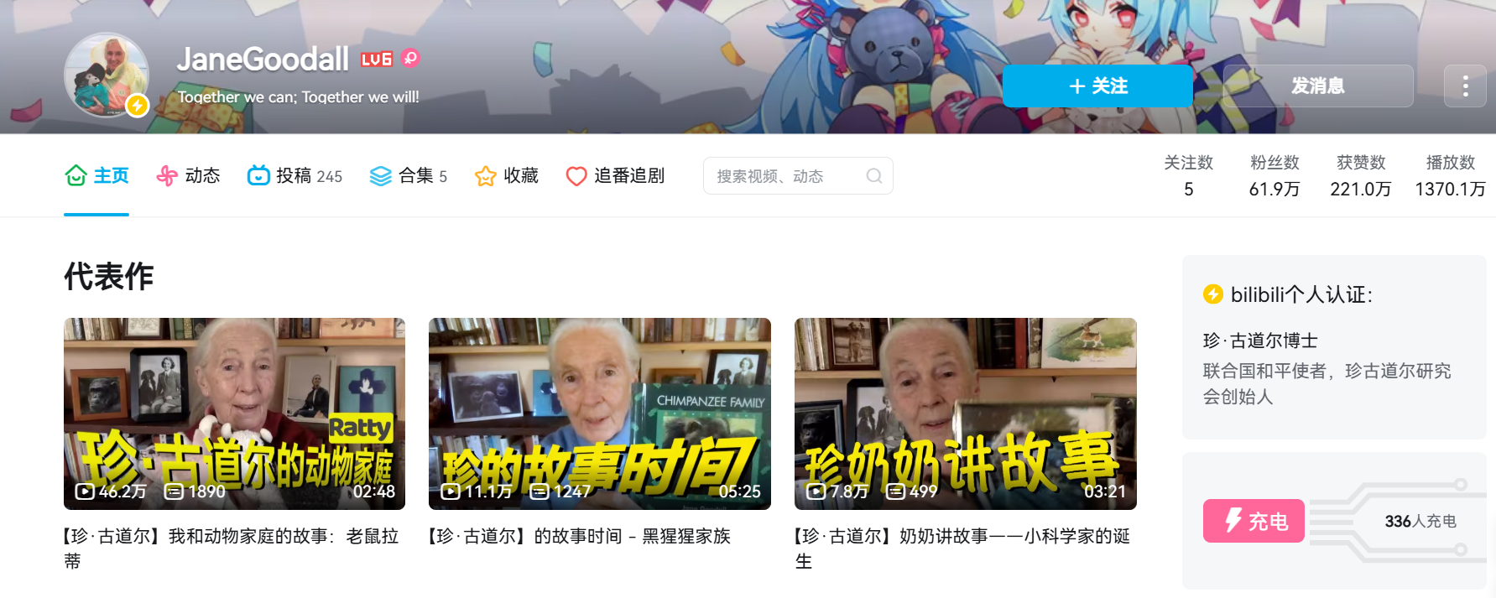

Post-reading

Slide 14
Para.8
How did she never give up in her life ？Fine some details in the passages.
She never gave up when she...
参考：
1、She never gave up when she worked hard to make her dream job come true.
2、When she worked in Africa，she never gave up studying chimpanzees in the difficult environment.
3、When she faced the questions from some people，she never gave up.
......

Slide 15
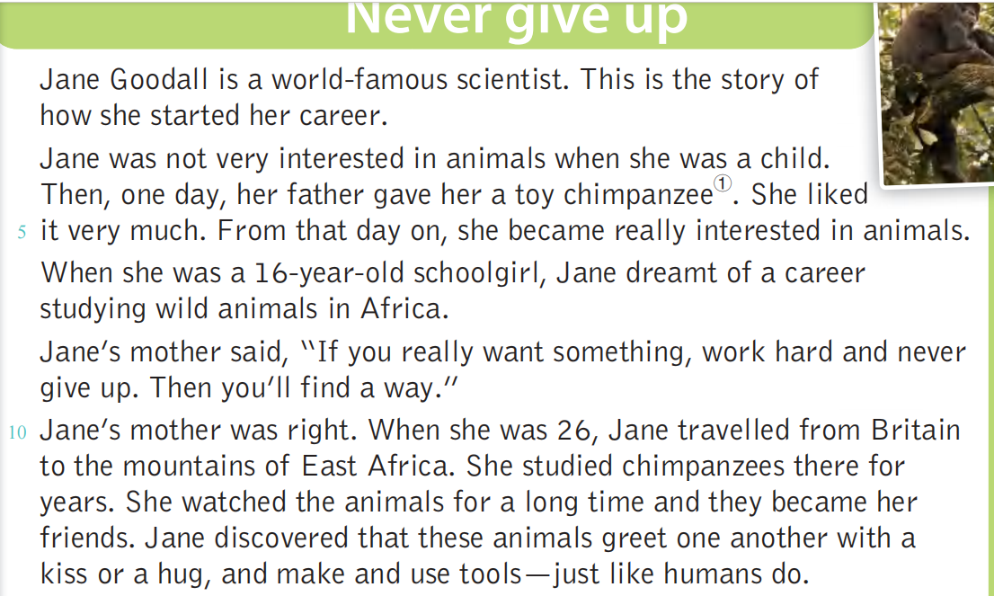
从那天起
dream of doing sth. 梦想做某事
give up doing sth. 放弃做某事
greet ...with...用...问候
one another 互相

Slide 16
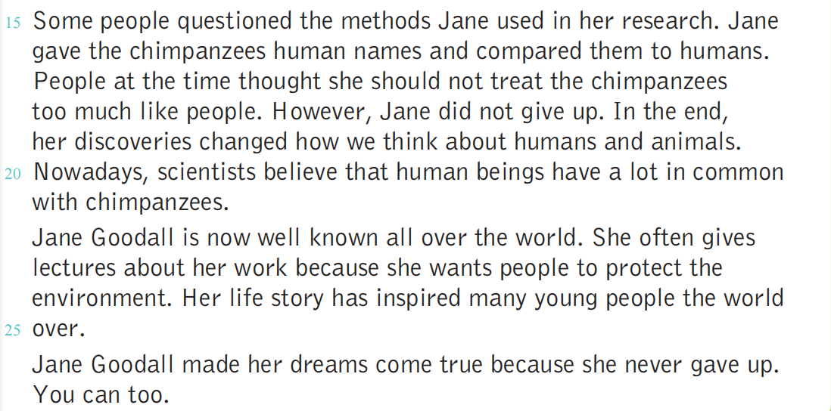
compare...to...把...比作...
最后
和...有许多相同之处
做演讲
make one’s dream come true 使某人梦想实现

Slide 17
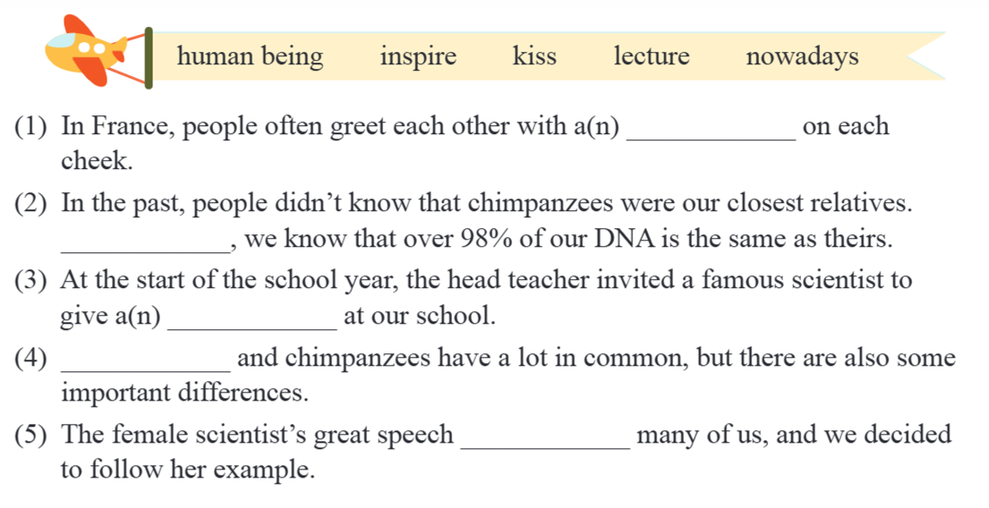
Complete the sentences with the words and the phrase below. Change the form if necessary.
kiss
nowadays
lecture
Human beings
inspired

