Slide 1

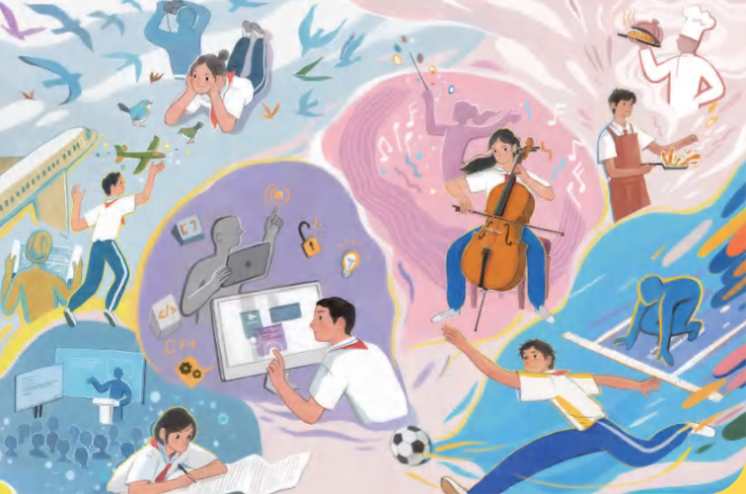

Unit 8 Follow your interests
主题范畴：
人与自我
主题群：
做人与做事
子主题：
职业启蒙，职业精神
  Key question:
  How can we turn our
  interests into a career?

Slide 2
Listening 语言知识复习
1、我爸爸过去常常带我和姐姐周末坐船出行。
My father___________take my sister and me for a trip on a boat___________.
2、我开始爱上帆船并把我所有空闲时间都用来玩帆船。（spend...doing）
____________________________________________
3、我对我的第一份工作不满意因为它很无聊。（be happy with）
____________________________________________
4、我决定把我的爱好变成职业。（turn...into）
____________________________________________
5、我的梦想工作是成为一名帆船教练（sailing teacher）。
____________________________________________
used to at weekends
I bagan to love sailing and spent all my free time sailing.
I wasn’t happy with my first job because it was boring.
I decided to turn my hobby into a career.
My dream job is to be a sailing teacher.

Slide 3
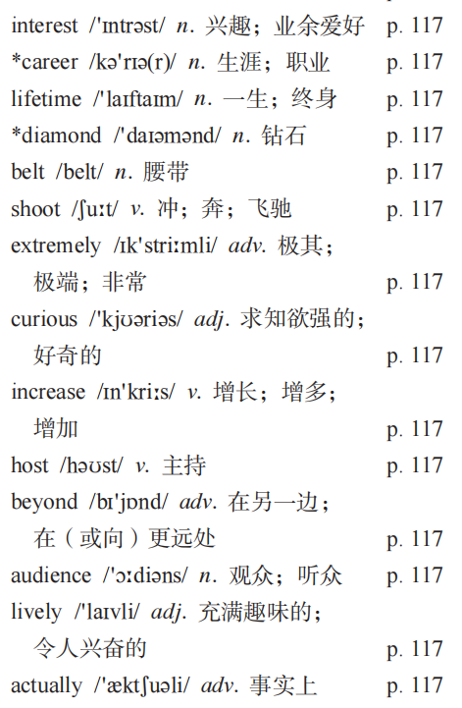


Slide 4






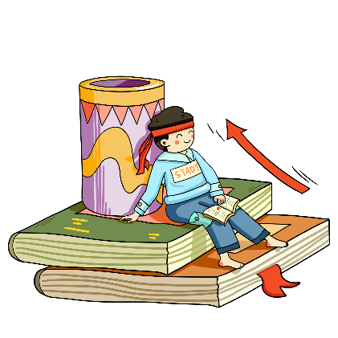

interest /ˈɪntrəst/ n. 兴趣；爱好；v. 让人感兴趣
interesting adj. 令人感兴趣的
interested adj. 感到有兴趣的
show interest in 对…感兴趣
have no interest in 对......没有兴趣

Slide 5

career /kəˈrɪə(r)/ n. 事业；职业；生涯
eg. Teaching is a meaningful career.
eg. She plans to start her career in medicine.
eg. Career choices are important for teenagers.
教师是一个有意义的职业
她计划开始她的医学生涯
职业选择对青少年很重要

Slide 6

lifetime /ˈlaɪftaɪm/ n. 一生；寿命；终生
once in a lifetime 一生一次
lifetime achievement 终身成就
eg. This is a once-in-a-lifetime opportunity.
eg. He dedicated his lifetime to helping others.
这是一个千载难逢的机会
他一生致力于帮助他人

Slide 7
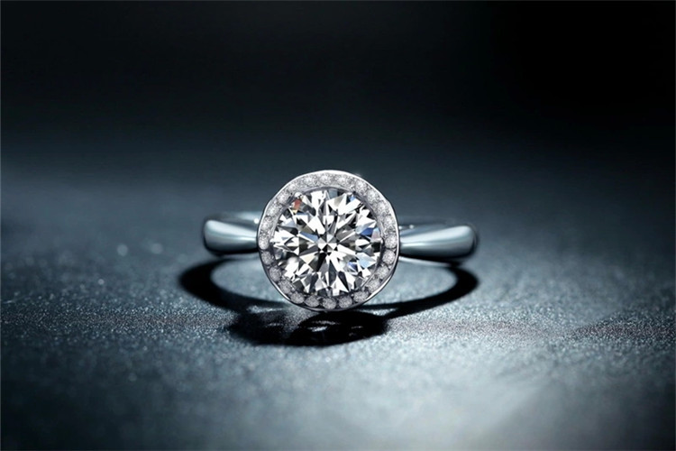
diamond /ˈdaɪəmənd/ n. 钻石；金刚石
diamond ring 钻石戒指
eg. Her ring has a shining diamond.
eg. Diamonds are the hardest natural material.
eg. This is not a diamond, but worthless glass.
她的戒指有一颗闪亮的钻石
钻石是最坚硬的天然材料
这不是钻石，而是没有价值的玻璃

Slide 8

belt /belt/ n. 腰带；带子
seat belt 安全带
eg. Fasten your seat belt before driving.
eg. He wore a leather belt with his jeans.
开车前系好安全带
他用牛仔裤系了一条皮带

Slide 9
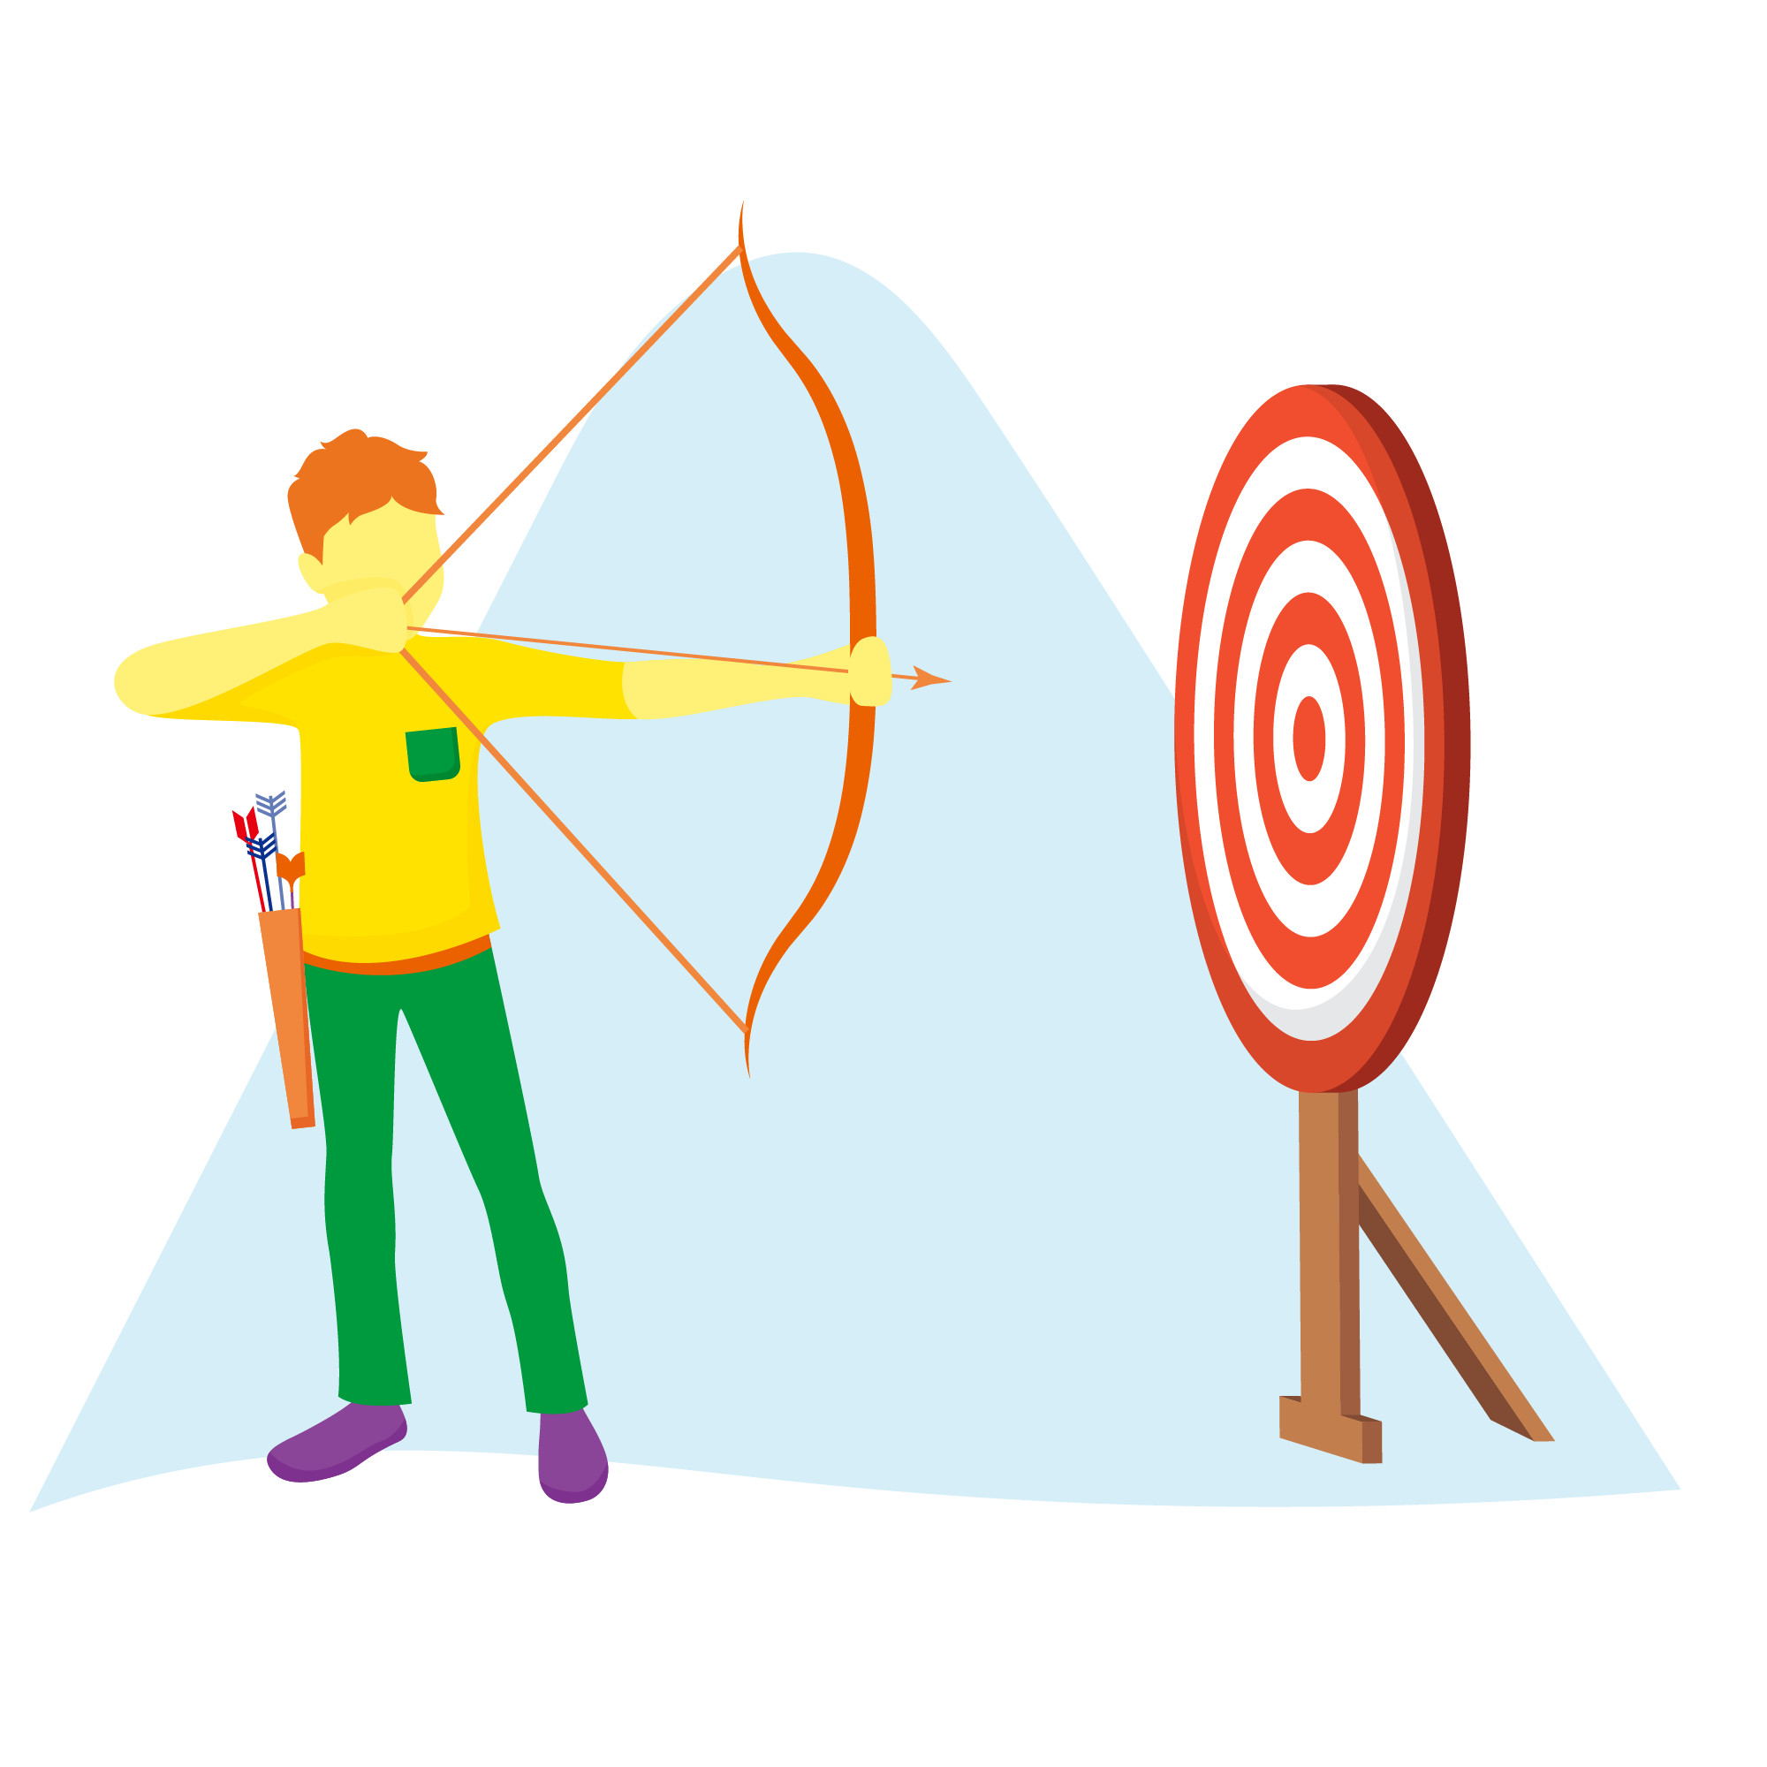
shoot /ʃuːt/ v. 冲；奔；飞驰
shoot-shot(过去式)-shot(过去分词)
shooter n. 射手
shoot a goal 射门得分
shoot at 力争；向…射击
eg. They are shooting a new film in the city.
eg. The basketball player shot the ball into the net.
他们正在城里拍摄一部新电影
篮球运动员将球射入网内

Slide 10
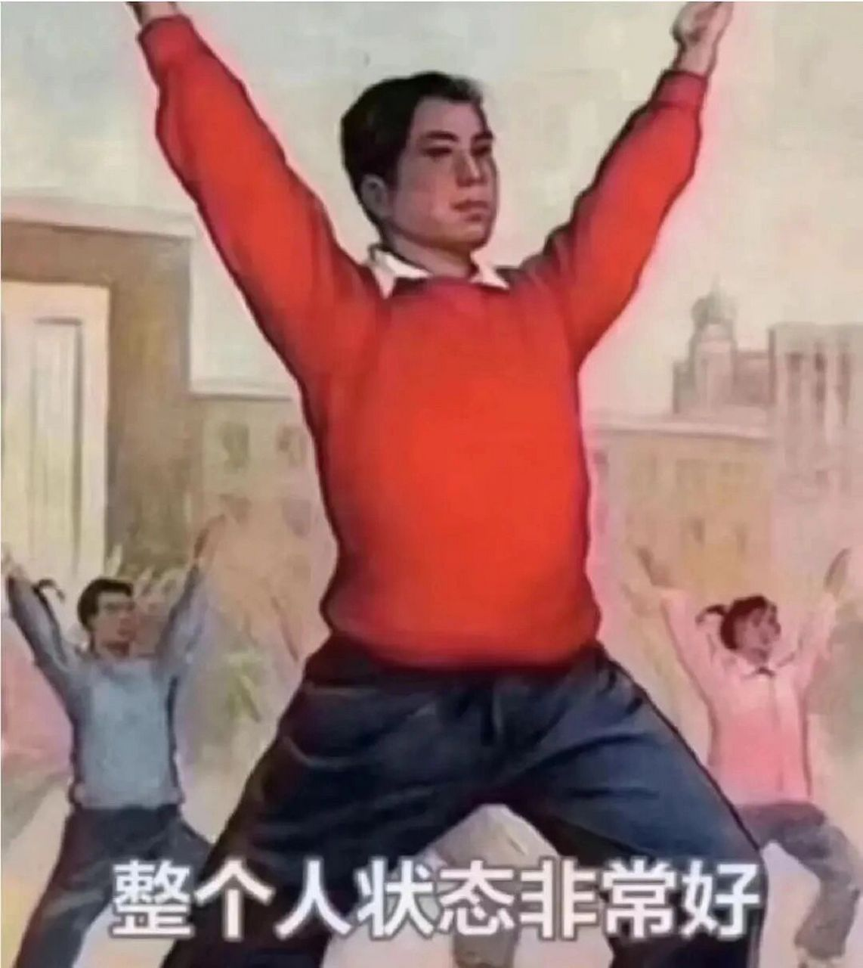
extremely /ɪkˈstriːmli/ adv. 极其；极端；非常
extreme adj. 极端的；极度的
extremely useful 非常有用
extremely important 极其重要
eg. The weather is extremely hot today.
eg. This problem is extremely difficult to solve.
今天的天气非常炎热
这个问题极其难解决

Slide 11
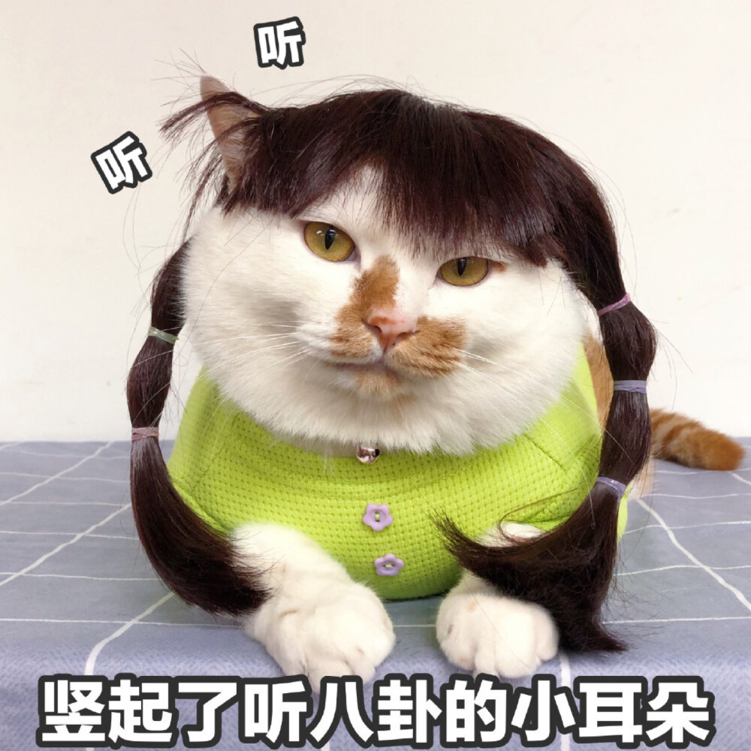
curious /ˈkjʊəriəs/ adj. 求知欲强的； 好奇的
curiously adv. 好奇地；奇怪地
curiosity n. 好奇心
be curious about 对......好奇

Slide 12

curious /ˈkjʊəriəs/ adj. 求知欲强的； 好奇的
eg. The cat is curious about the moving shadow.
eg. She gave me a curious look when I entered the room.
猫对移动的影子很好奇‌
当我进入房间时，她给了我一个奇怪的表情‌
1. The students show great ______ (curious) about the experiment.
2. He _________ (curious/curiously) opened the old box.
3. 孩子们对恐龙很好奇
翻译：
curiosity
curiously
The children are curious about dinosaurs.

Slide 13

increase /ɪnˈkriːs/ v. 增长； 增多； 增加
decrease （反）v. 减少；减小
increasing adj. 渐增的；越来越多的
increase by 增长了
increase to 增加到
eg. The population of the city has increased by 20%.
eg. The price of food is increasing rapidly.
该市人口增加了20%‌
食品价格正在快速上涨‌

Slide 14
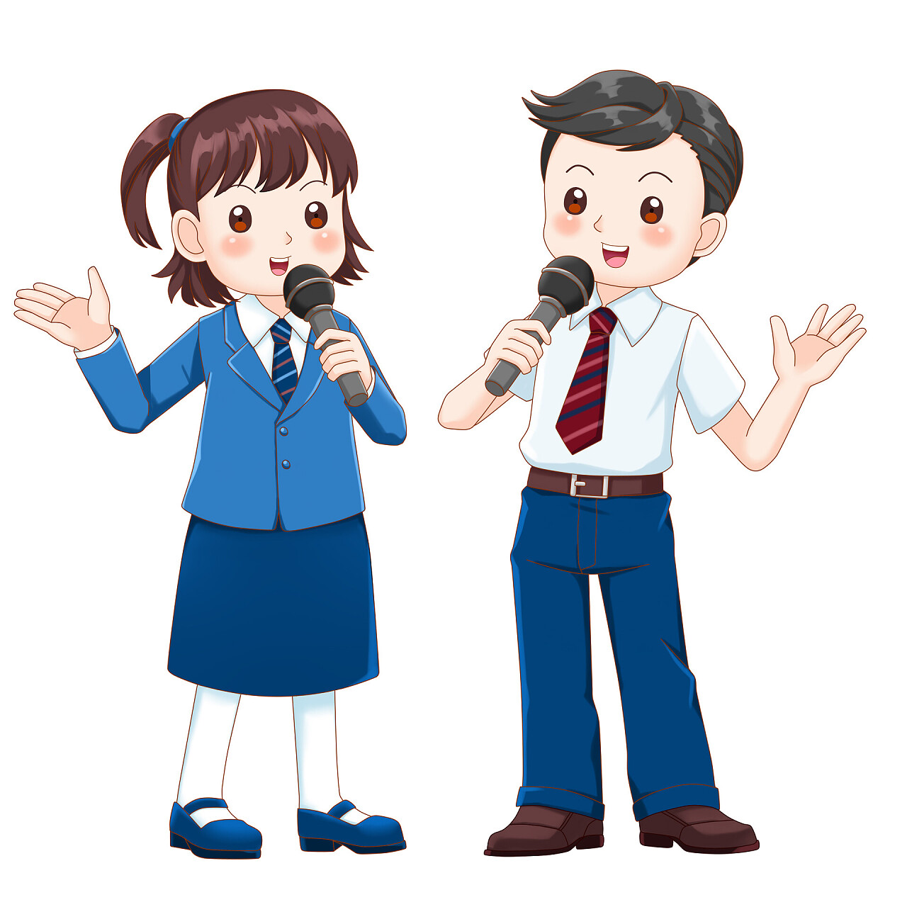
host /həʊst/ v. 主持；n. 主人；主持人
hostess n. 女主人
host a party 举办派对
host country 主办国
eg. China will host the next Olympic Games.
eg. The host welcomed the guests warmly.
中国将主办下一届奥运会
主持人热情地欢迎客人

Slide 15
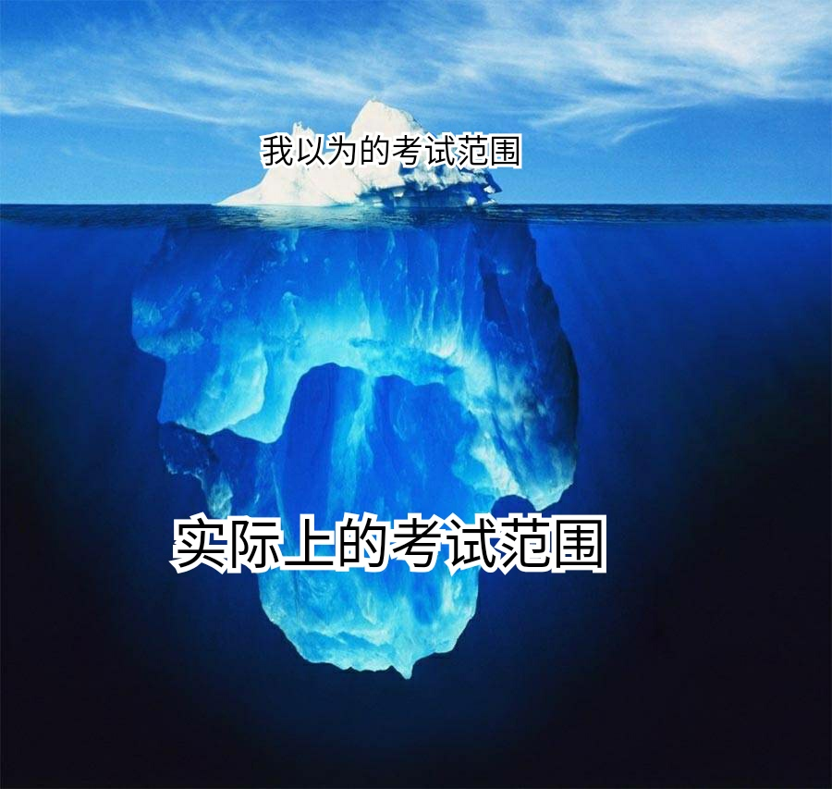
beyond /bɪˈjɒnd/ adv. 在另一边；prep. 超过；越过
go beyond 超越
beyond control 无法控制
beyond belief 难以置信
beyond question 毫无疑问
eg. His kindness is beyond belief.
eg. We should go beyond our limits.
他的善良令人难以置信
我们应该超越我们的极限

Slide 16
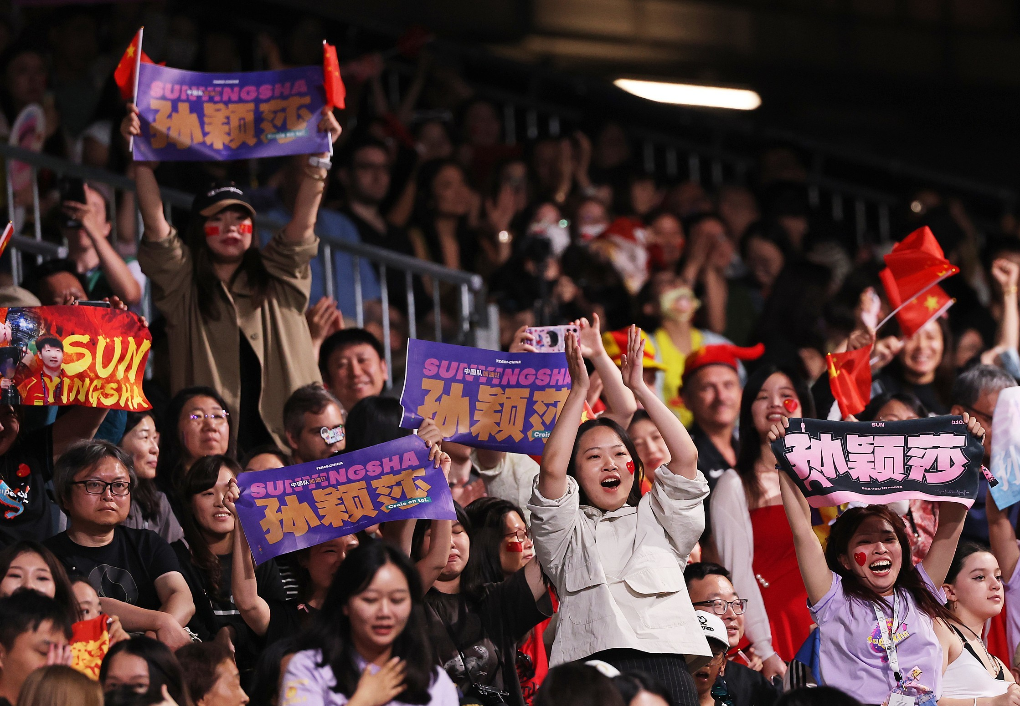
audience /ˈɔːdiəns/ n. 观众；听众
eg. The audience clapped loudly after the concert.
eg. This movie is aimed at a young audience.
音乐会结束后，观众热烈鼓掌
这部电影的目标观众是年轻人

Slide 17
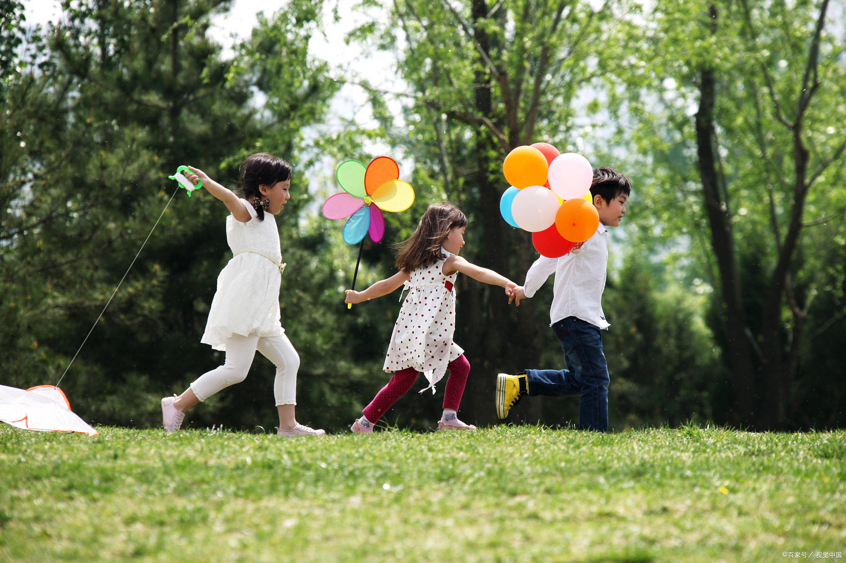
lively /'laɪvlɪ/ adj. 充满趣味的；令人兴奋的
liveliness n. 活泼
a lively child 活泼的孩子
eg. Her lively personality makes her popular.
eg. The party had lively music and dancing.
她活泼的性格让她很受欢迎
派对上播放着欢快的音乐，大家跳着舞

Slide 18

actually /ˈæktʃuəli/ adv. 实际上；事实上
actual adj. 真实的；实际的
actually speaking 老实说
actually do sth 真的做了某事
eg. Actually, I don’t agree with your opinion.
eg. The movie was actually better than I expected.
事实上，我不同意你的观点
这部电影实际上比我想象的更好

Slide 19
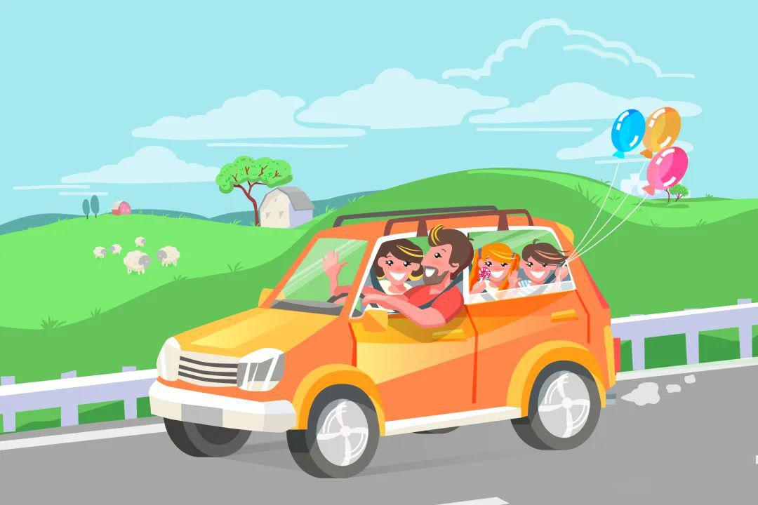
go outside 外出；出去；出门
go outside and see 到外面看看
go outside and walk 请出去走走
eg. It's raining hard. We can't go outside now.
eg. Let's go outside and play basketball!
eg. My mom says I can go outside after finishing homework.
雨下得很大，我们现在不能出去
我们出去打篮球吧
妈妈说写完作业后我可以出去玩

Slide 20

more and more 越来越多
more and more widely 越来越广泛
more and more confident 越来越自信
eg. The story gets more and more interesting.
eg. The air is becoming more and more polluted.
eg. She feels more and more confident when speaking English.
这个故事越来越有趣了
空气污染越来越严重了
她说英语的时候越来越自信了

Slide 21
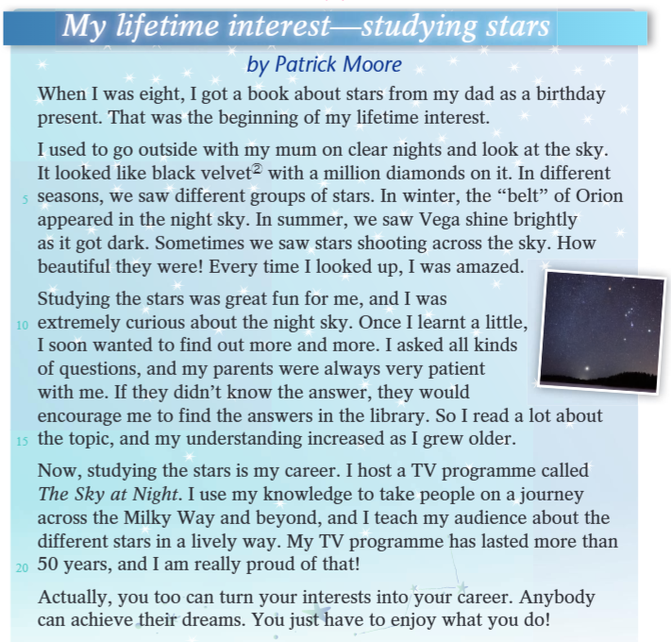

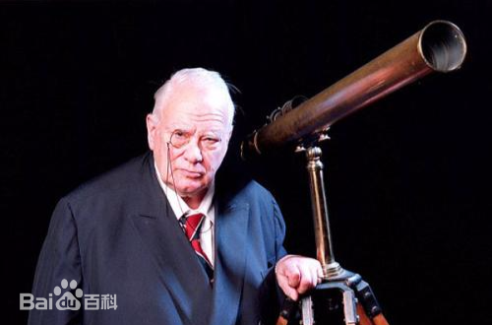

P117
Read the article by Patrick Moore (1923 -2012), a British amateur astronomer, and find out how he turned his interest into a career.

Slide 22
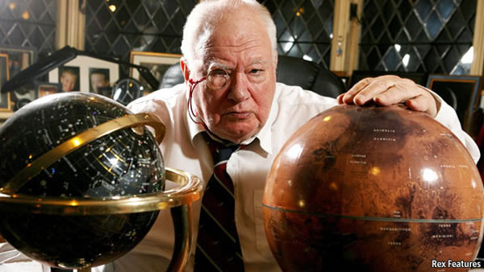
帕特里克·阿尔弗雷德·考德威尔-摩尔（Patrick Alfred Caldwell-Moore，1923年3月4日－2012年12月9日），英国业余天文学家、作家、研究者、广播评论员及电视节目主持人，出生于米德尔塞克斯平纳。他长期主持BBC天文科普节目《仰望夜空》，该节目自1957年开播后成为全球播出时间最长的电视节目。摩尔曾担任英国天文协会主席，撰写70余部天文学著作，并编纂科德韦尔深空天体表，为英国天文学发展及公众科学教育做出重要贡献。

Slide 23
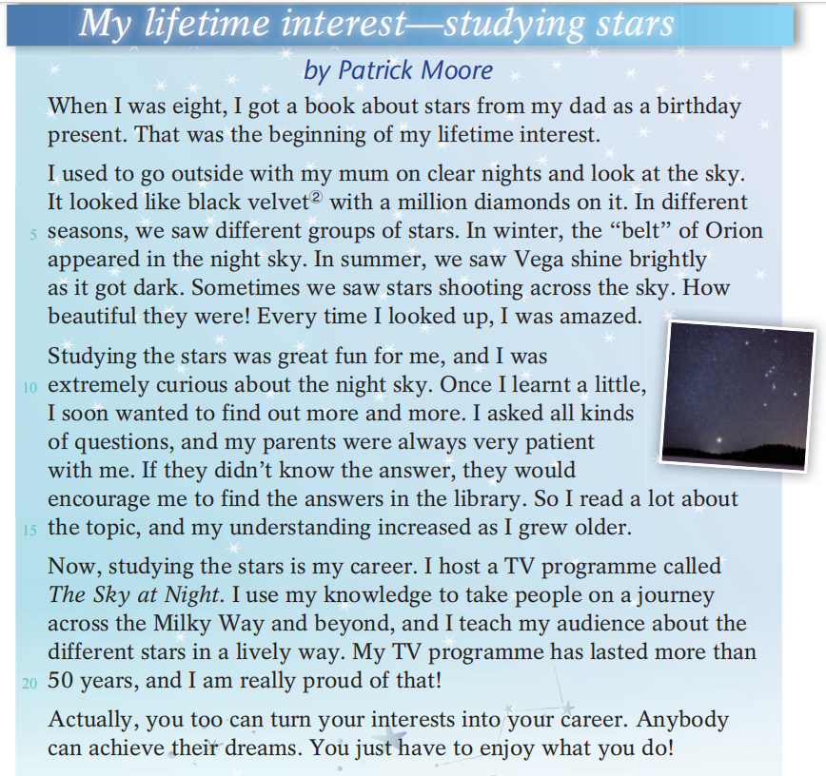
1. What is Patrick Moore’s hobby?
Studying stars.
2.What is the genre (体裁)?
A. Narration (记叙文)
B. Argumentation (议论文)
C. Exposition (说明文)
3.In what order does the author describe the story?
Time order.

Slide 24
Read and find out the answers.
1. When did he start his interest?
2. How did he start his interest?
3. What is his job now?
How did Patrick Moore turn his interest into his career?

Slide 25
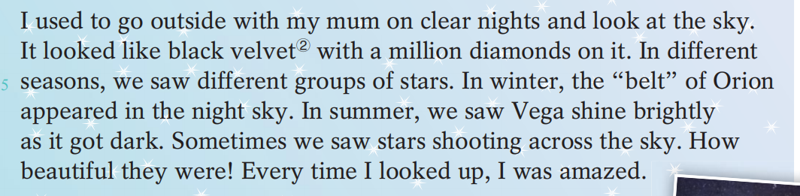
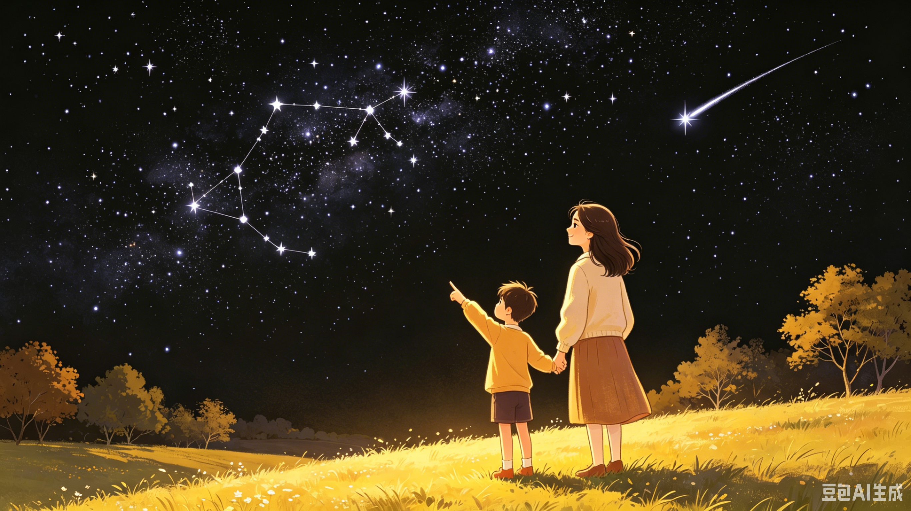
Para.2
黑丝绒
钻石
['vi:gə]织女星
猎户座的“腰带”[əʊˈraɪən]
划过天空
1、What is the main idea of this paragraph?
A. The writer learned how to find stars in the sky.
B. The writer used to enjoy watching stars with her mum on clear nights.
C. The writer’s favourite star in the night sky is Vega.
D. The writer saw many shooting stars in the sky every night.
2、What could he see in the sky？
3、How did he feel about the sky？Why？

Slide 26
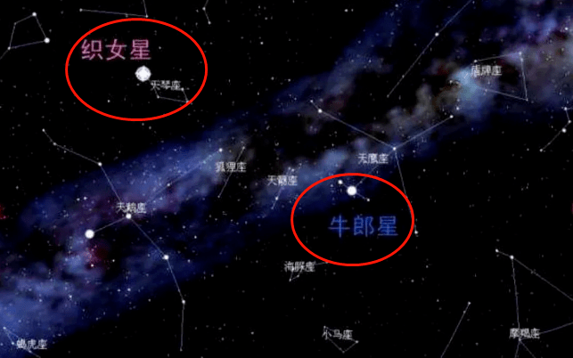
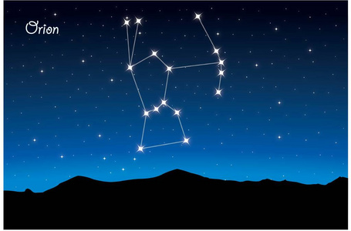

Slide 27
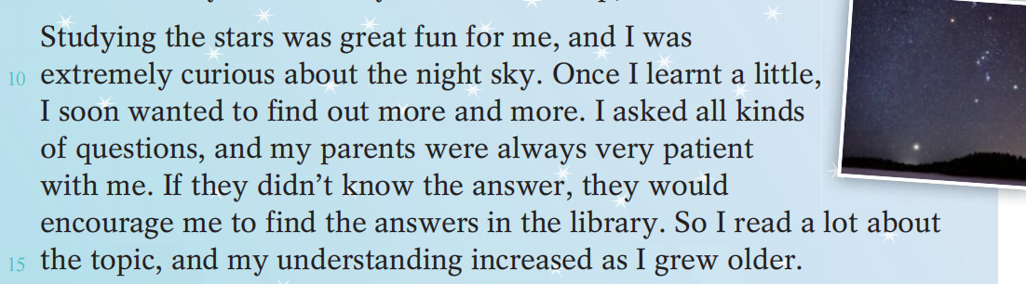
Para.3
1、What did the writer think of studying stars？
2、What does “ curious” mean？Any suppoting details？
3、What can we learn about the writer's parents？
They were patient and always encouraged the writer to learn a lot.
4、What do you think helped him increase his understanding？
Reading a lot
about the topic.
His curiosity and his parents’ encouragement.

Slide 28
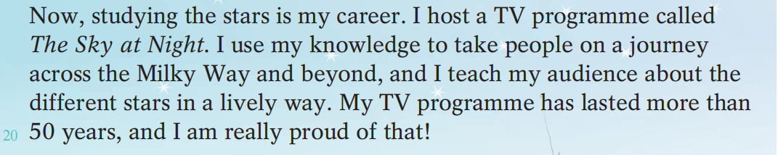
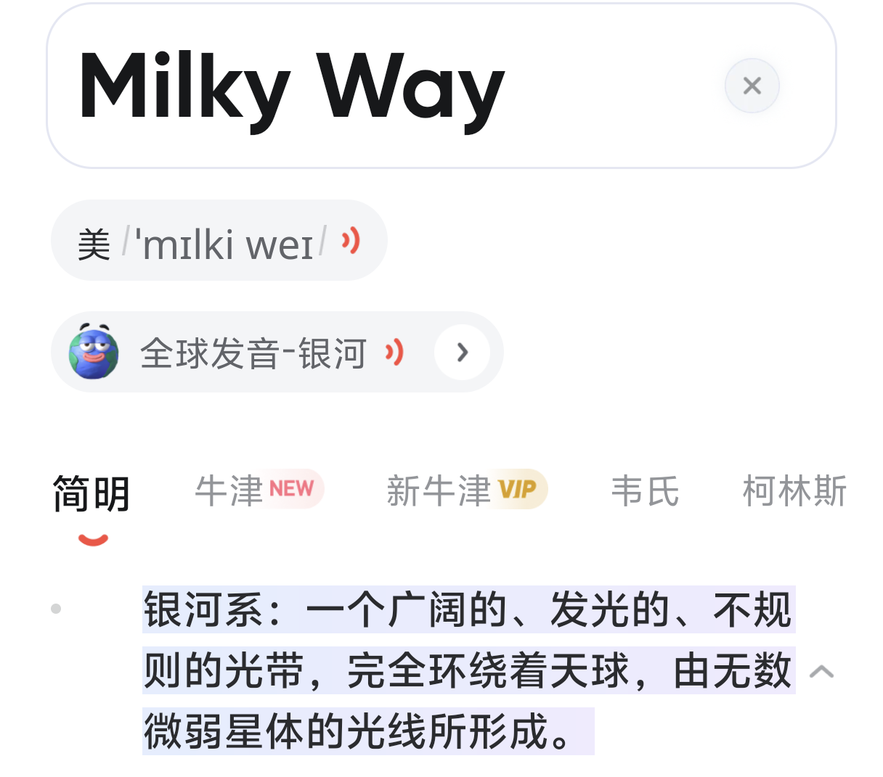
Para.4
我用自己的知识，带领观众开启一场穿越银河系、甚至更遥远宇宙的旅程，用生动有趣的方式为大家讲解不同的恒星。
1、What does the writer do in his programme？
2、Do audience like watching his programme？
3、What can we infer from the sentence "I am really proud of that!"?
A. He is proud of how long his programme has lasted
B. He is proud of being a TV host
C. He is proud of his knowledge about stars
D. He is proud of his audience

Slide 29
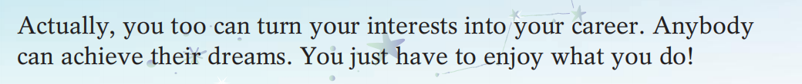
Para.5
1、What does the writer want to tell us in the last paragraph?
A. Everyone must become a scientist
B. Turning interests into a career is the only way to success
C. You can achieve your dreams if you love what you do
D. Only people who study stars can achieve their dreams
2、The writer says "Anybody can achieve their dreams. You just have to enjoy what you do!" Do you agree with this? Why or why not?
I agree. When you enjoy what you do, you will keep learning and working hard even when it's difficult. Just like the writer, his love for stars kept him interested for over 50 years, and that helped him succeed.

Slide 30
Think：
Why do you think Patrick Moore was able to turn his interest into his career? Find some clues in the text.
① His deep interest and love for stars (from childhood curiosity to lifelong passion)
②His supportive family
③ His ability to teach others in a lively way
④His persistence 坚持
hobby
efforts
career

Slide 31
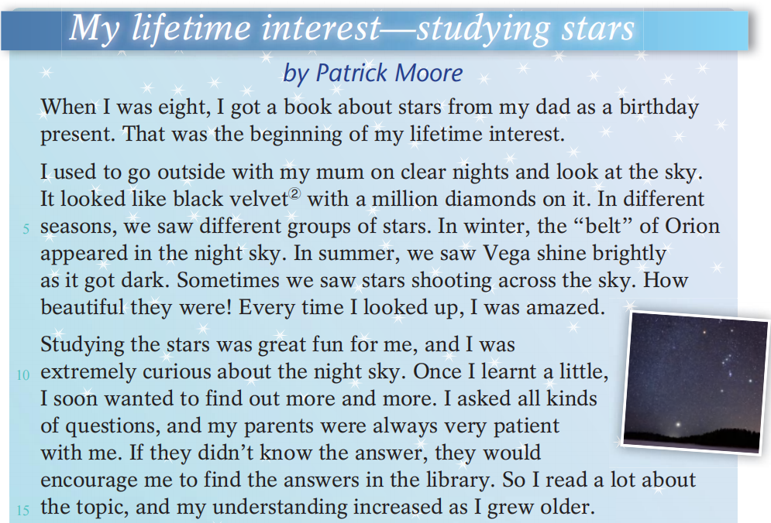
一生的兴趣
...的开始
在晴朗的晚上
see...do sth.
看见...做某事
see...doing sth.
看见...正在做某事
看起来像
划过天空
动词做主语用ing 形式
研究星星对我来说是一大乐趣
be curious about 对...好奇
一旦
越来越多
各种各样
grow older长大

Slide 32
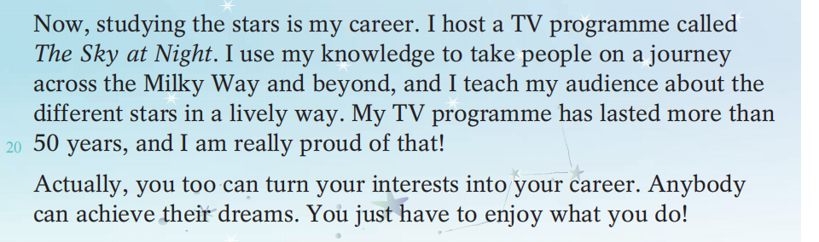
use...to...用...做某事
用一种生动的方式
be proud of...对...感到自豪
把你的兴趣变成职业
achieve one’s dream 实现某人的梦想

Slide 33
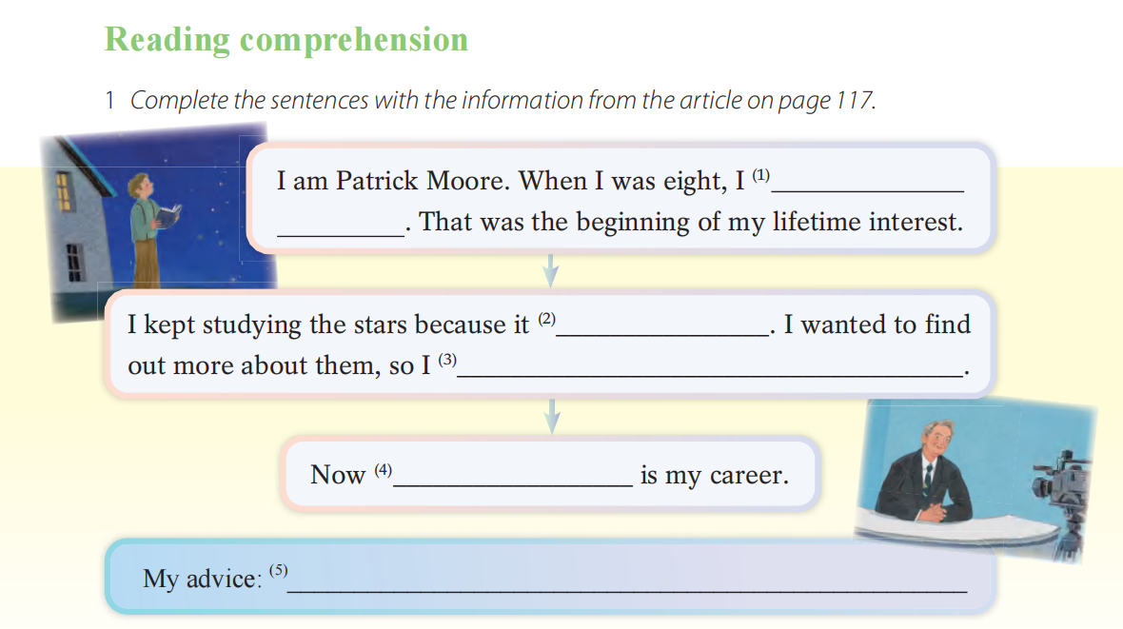
P118
got a book about stars from my dad as a birthday present
was great fun for me
asked all kinds of questions and read a lot about the topic.
studying the stars
Anybody can achieve their dreams. You just have to enjoy what you do!

Slide 34
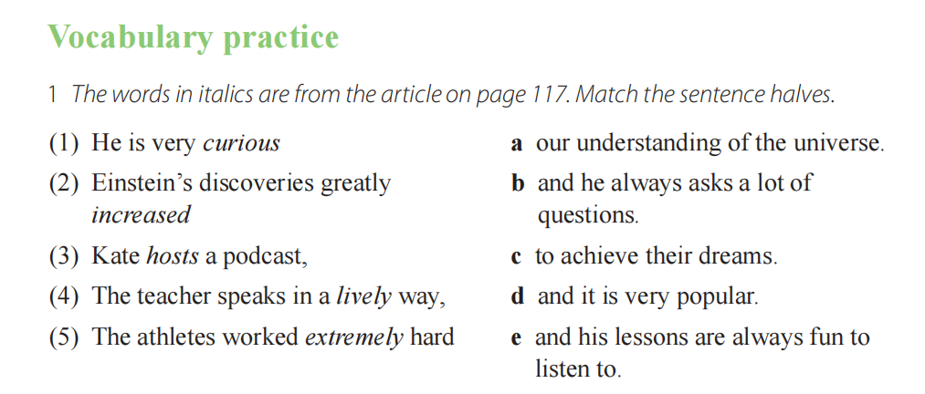
P119

Slide 35
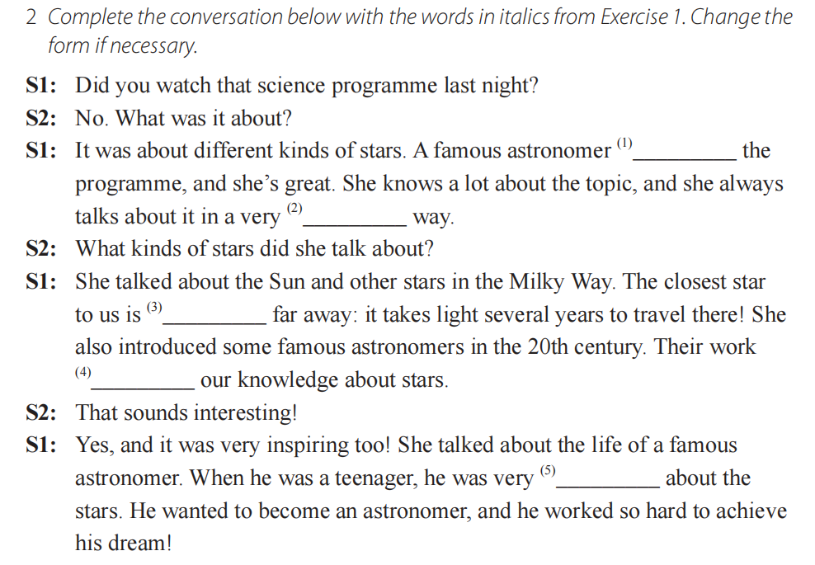
hosts
lively
extremely
increased
curious

