Slide 1

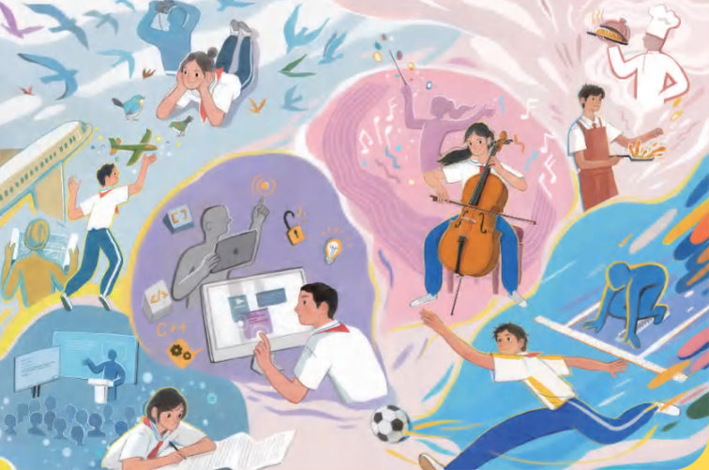
Unit 8 Follow your interests
主题范畴：
人与自我
主题群：
做人与做事
子主题：
职业启蒙，职业精神
  Key question:
  How can we turn our
  interests into a career?
话题学习

Slide 2






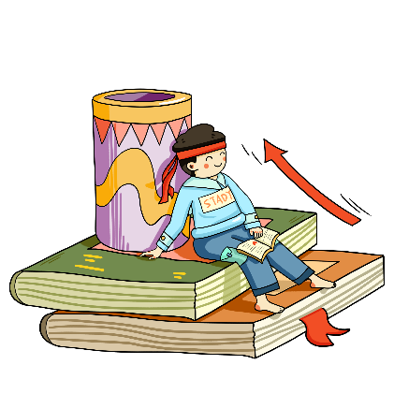

possible /ˈpɒsəbl/ adj. 可能的；也许的
possibly adv. 可能地；大概
impossible adj. 不可能的
as soon as possible 尽快
make it possible 使成为可能
anything is possible 一切皆有可能
It’s possible that... 有可能......

Slide 3

possible /ˈpɒsəbl/ adj. 可能的；也许的
eg. Please reply as soon as possible.
eg. Technology makes it possible to communicate globally.
请尽快回复
技术使全球通信成为可能
1. It’s __________ (possible) to live without water.
2. He _________ (possible/possibly) forgot the meeting.
3. 尽可能快地完成你的项目
翻译：
impossible
possibly
Finish your project as soon as possible.

Slide 4
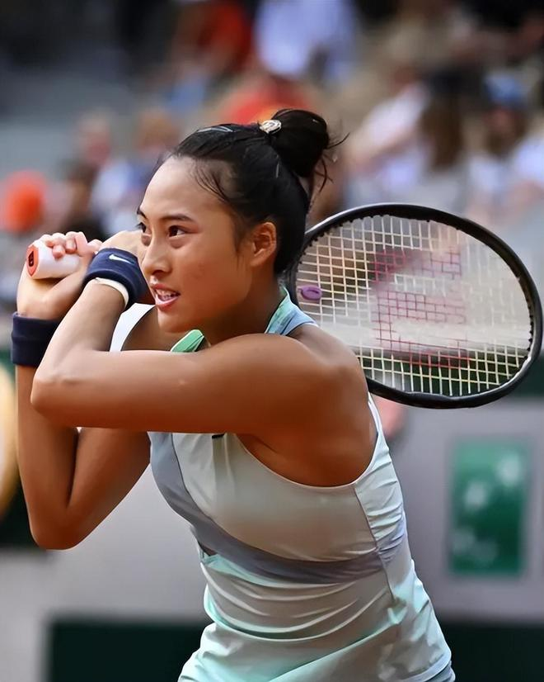
athlete /ˈæθliːt/ n. 运动员；体育家
athletic adj. 运动的；运动员的
athletic sports 体育运动
athletic meeting 运动会
eg. I want to be an athlete.
eg. Michael Phelps is a famous Olympic athlete.
我想成为一名运动员
迈克尔·菲尔普斯 (Michael Phelps) 是一位著名的奥林匹克运动员

Slide 5

biologist /baɪˈɒlədʒɪst/ n. 生物学家
biology n. 生物学；生物
biologic adj. 生物的；生物学的
eg. The biologist discovered a new insect species.
eg. She wants to be a biologist in the future.
生物学家发现了一种新的昆虫物种
她将来想成为一名生物学家

Slide 6
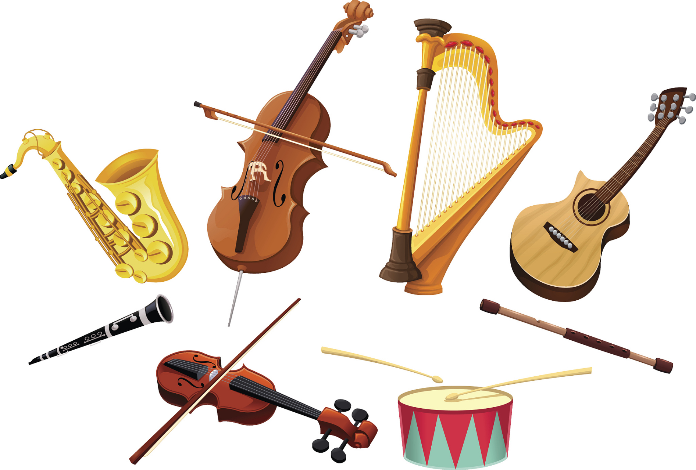
instrument /ˈɪnstrəmənt/ n. 乐器；仪器
play an instrument 演奏乐器
eg. The piano is her favorite instrument.
eg. Music class teaches students to play instruments.
钢琴是她最喜欢的乐器
音乐课教学生演奏乐器

Slide 7
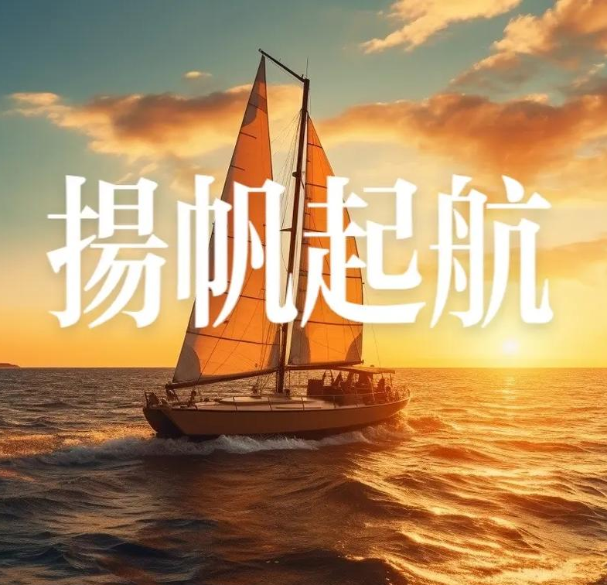
sail /seɪl/ v. 驾驶（或乘坐） 帆船航行；启航
sailor n. 水手；海员
sailing n. 航行；航海
eg. They will sail to Japan next week.
eg. She sailed through the exam easily.
他们下周将乘船去日本
她轻松通过了考试

Slide 8
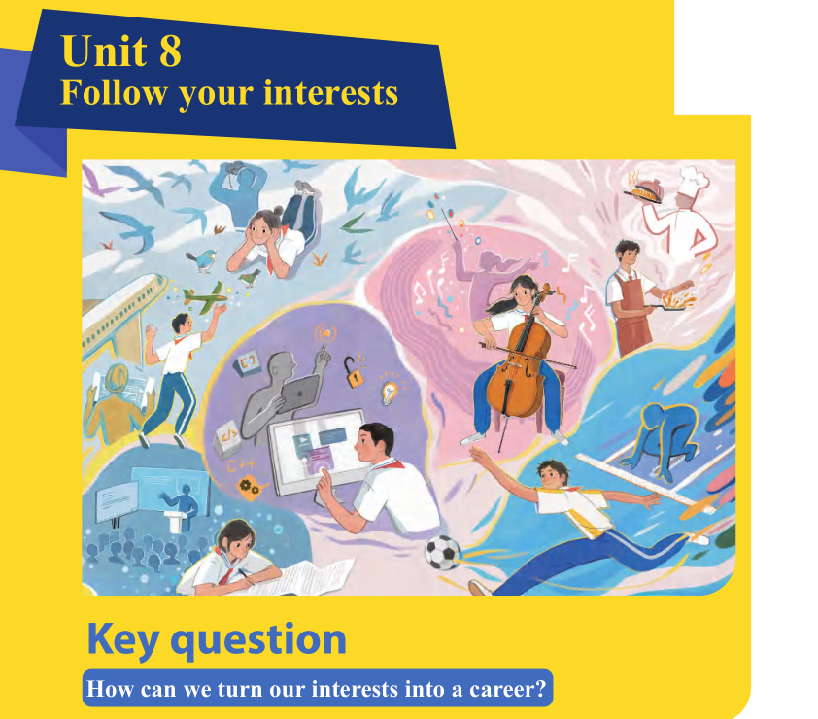
P114
interest n. 兴趣
interested adj. 感兴趣的
interesting adj. 有趣的
turn...into...把...变成...
career [kəˈrɪə] 职业

Slide 9
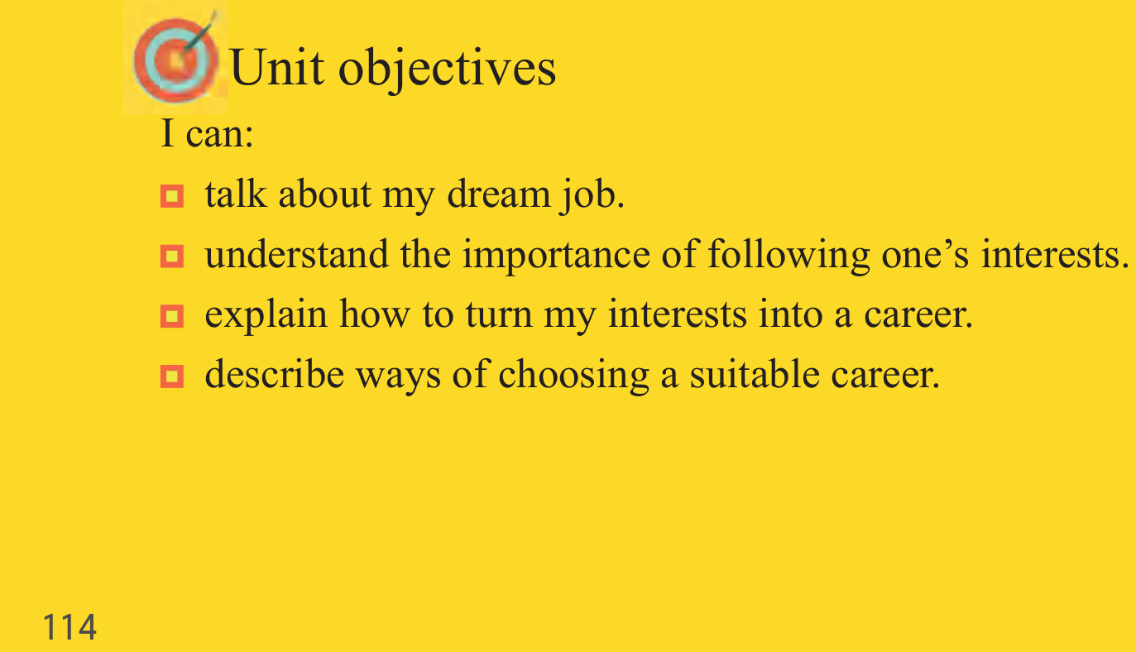
adj.合适的

Slide 10
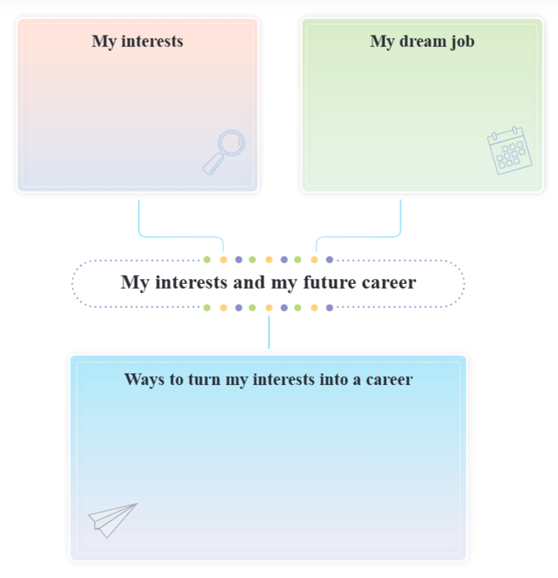
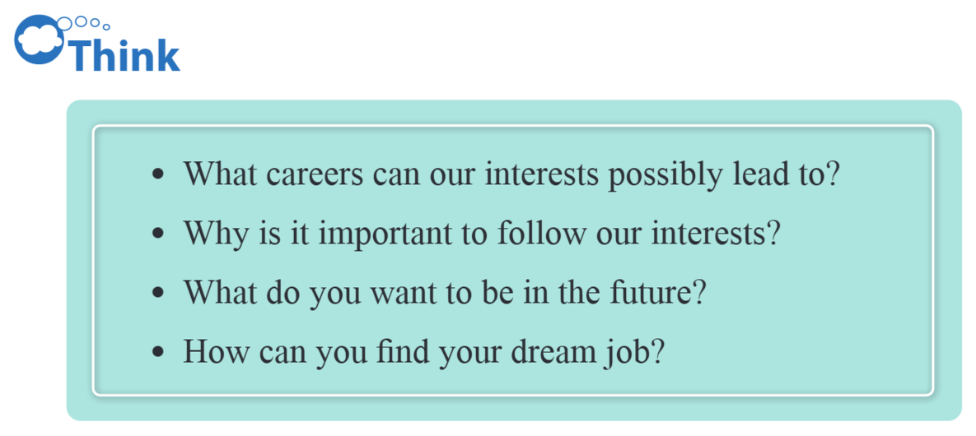
First thoughts
P115

Slide 11
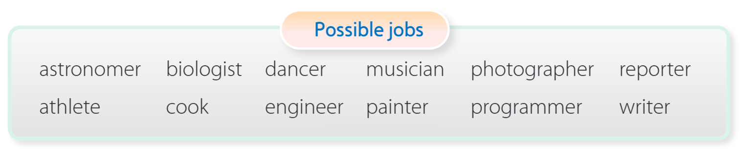
Before you read
P116
Look at the hobbies below and suggest possible jobs from the list. You can also suggest other jobs. Then discuss your interests and dream jobs in pairs.
[əˈstrɒnəmə]
天文学家
[baɪˈɒlədʒɪst]
生物学家
[fəˈtɒɡrəfə]
摄影师
[rɪˈpɔːtə]记者
[ˈæθliːt]
运动员
[ˈprəʊɡræmə]
程序员
chef 厨师 、teacher 、doctor、police officer、singer、guide导游、
designer 设计师

Slide 12
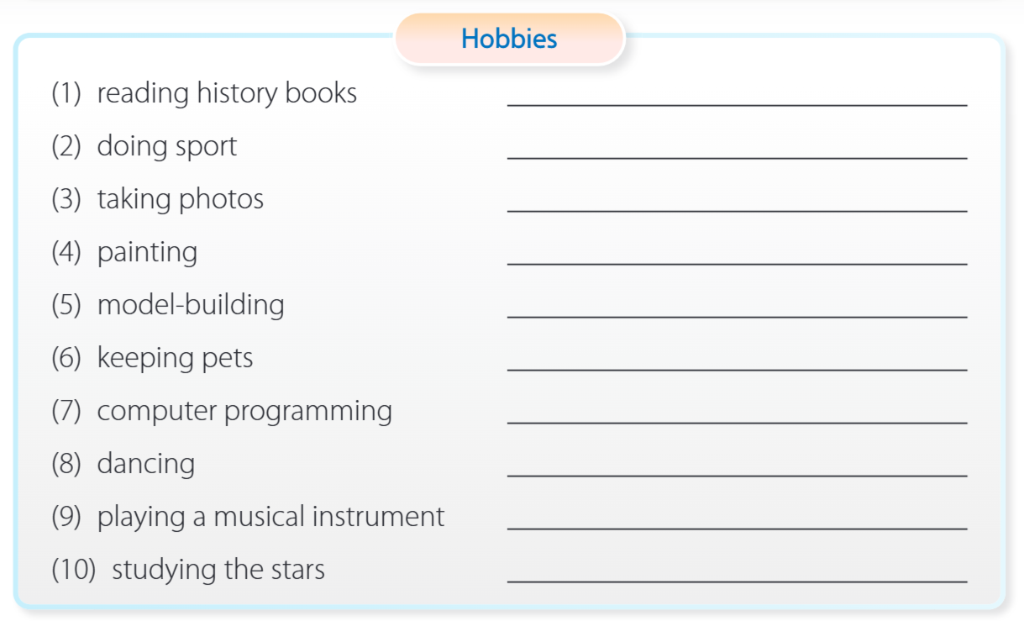
writer / historian
athlete
photographer / reporter
painter
engineer
biologist
programmar
dancer
[ˈɪnstrəmənt] 乐器
musician
astronomer

Slide 13
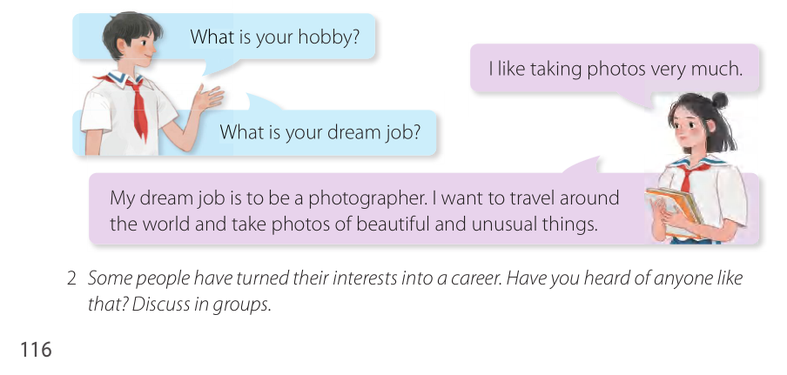

Slide 14
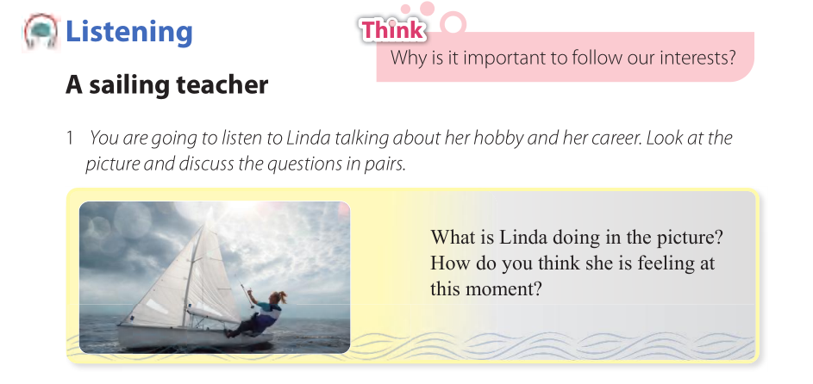
P120

Slide 15


While-listening
Listen to Linda’s talk and answer the questions.
(1) What was Linda’s first job? What did she think of it?
She got a job in an office. She thought it was boring.
(2) What is Linda’s job now? What does she think of it?
She is a sailing teacher. She thinks it’s the best job for her.
Listening Tips: Pay attention to the key words in the question. Time / Action / Characters / Feelings / Place ...

Slide 16
TASK 3 Listen and decide
Listen again. Decide whether the following statements are true (T) or false (F). Correct the false ones.
( )
( )
( )
( )
( )
(1) Linda’s family lived next to the sea.
(2) Linda learnt how to sail from her sister.
(3) When Linda worked in the office, she went sailing
every day.
(4) Linda took a training course before she became a
sailing teacher.
(5) Linda loves her job as a sailing teacher.
T
—— father
F
F
—— weekend
T
T

Slide 17

Tapescript
Hello, I’m Linda. I’d like to share how I turned my hobby into a career.
When I was a child, my family lived next to the sea. My dad used to take my sister and me for trips on his boat at weekends. I began to love sailing. When I got older, he taught me how to sail the boat myself. I loved the water and the fresh sea air. From then on, I spent all my free time sailing. It was my favourite hobby.
过去常常...
在周末
teach sb. to do
从那时起

Slide 18
After I left school, I got a job in an office, but I still went sailing every weekend. I wasn’t happy with my job. I found it very boring, and I thought about sailing every day. One day, I finally decided to leave my job and turn my hobby into a career. I took a training course to become a sailing teacher.
Now I teach people from all over the world how to sail safely.I’m very happy now because I love my job. I think it’s the best job for me.
去航海
be happy with...对...满意
把我的爱好变成一份职业
参加培训课程

Slide 19


TASK 4 Group discussion
Post-listening
Discuss the question below.
Why do you think Linda was able to turn her interest into a career?

Slide 20
have strong passion for sailing
Tapescript
got help from her dad and practiced a lot
Hello, I’m Linda. I’d like to share how I turned my hobby into a career.
When I was a child, my family lived next to the sea. My dad used to take my sister and me for trips on his boat at weekends. I began to love sailing. When I got older, he taught me how to sail the boat myself. I loved the water and the fresh sea air. From then on, I spent all my free time sailing. It was my favourite hobby.

Slide 21
insist on 坚持her interest
be brave to make a change
勇于做出改变
determined 有决心的
After I left school, I got a job in an office, but I still went sailing every weekend. I wasn’t happy with my job. I found it very boring, and I thought about sailing every day. One day, I finally decided to leave my job and turn my hobby into a career. I took a training course to become a sailing teacher.
Now I teach people from all over the world how to sail safely.I’m very happy now because I love my job. I think it’s the best job for me.
never give up
work hard

